Slide 1
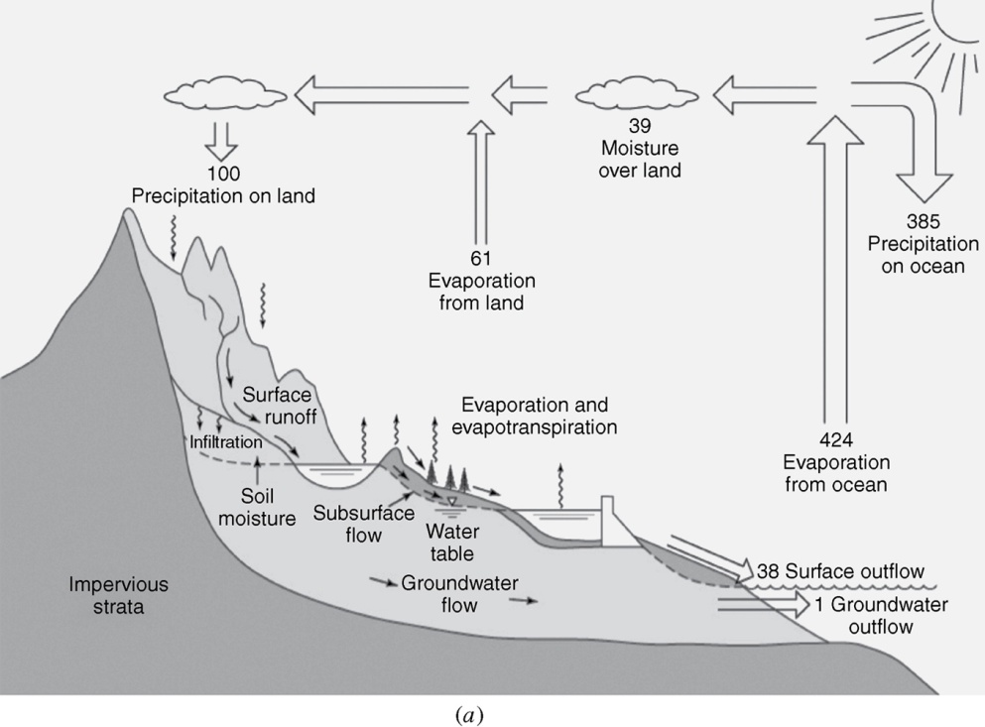
What is the percentage of global precipitation falling on the land?
From Mays, 2011, Ground and Surface Water Hydrology

Slide 2
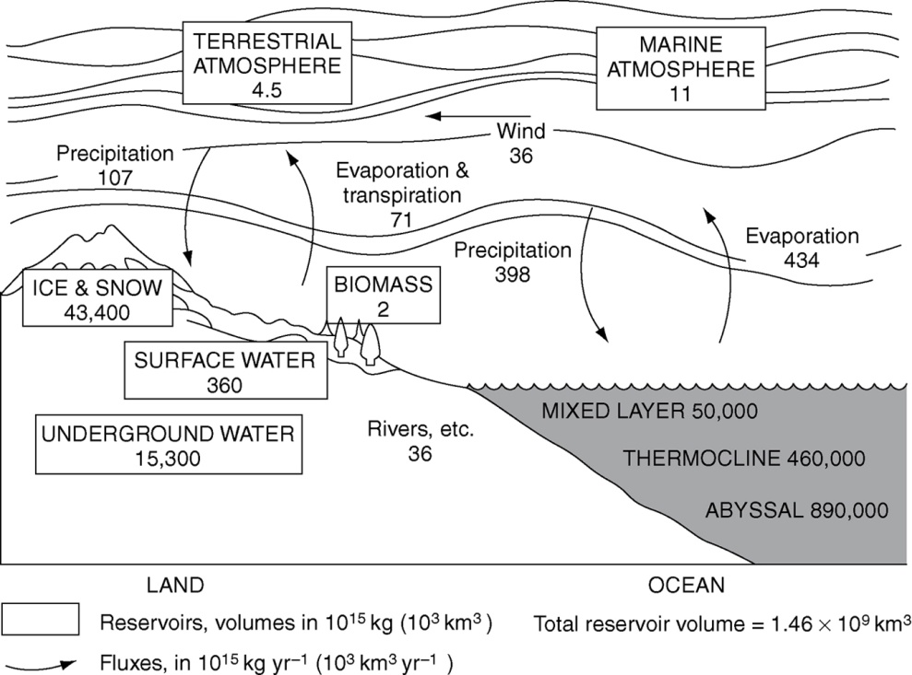
What percentage of water on the earth is surface water?
What is the average residence time of surface water?
What is the average residence time of water in the atmosphere?
From Mays, 2011, Ground and Surface Water Hydrology

Slide 3
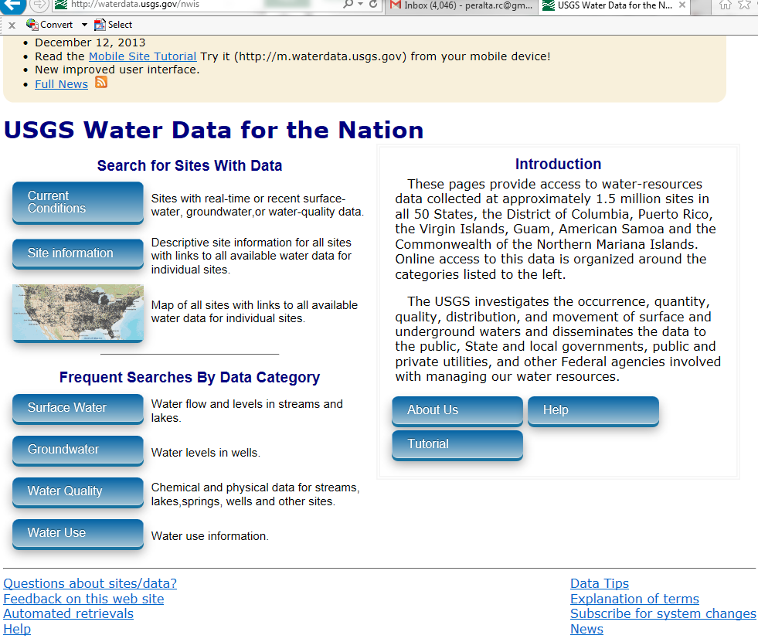
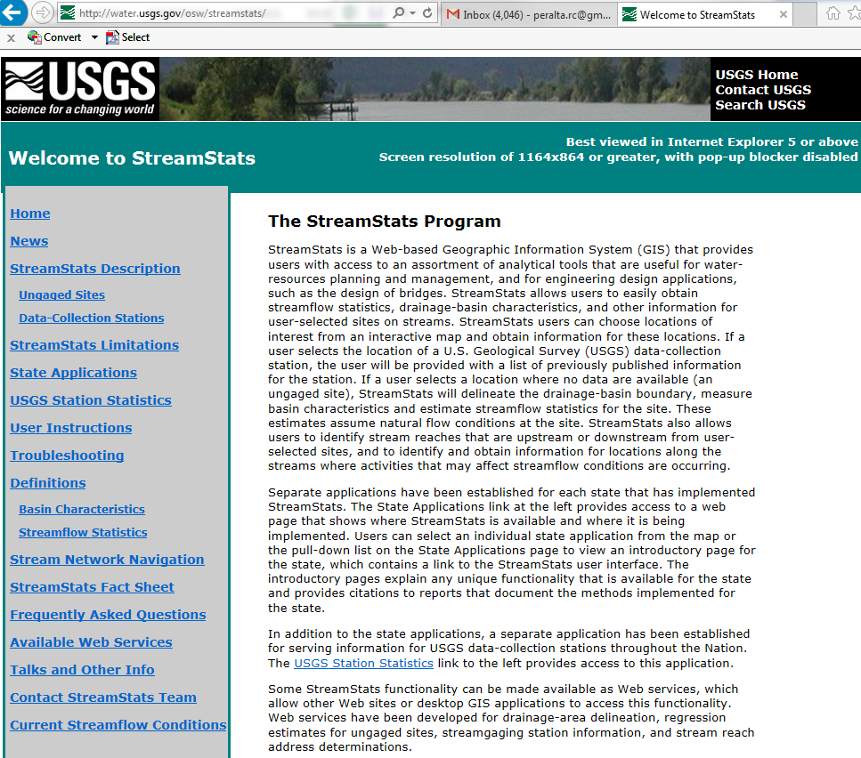
Hydrologic Data and Hydrologic Budget
USGS http://waterdata.usgs.gov
Streamstats http://water.usgs.gov/osw/streamstats/

Slide 4
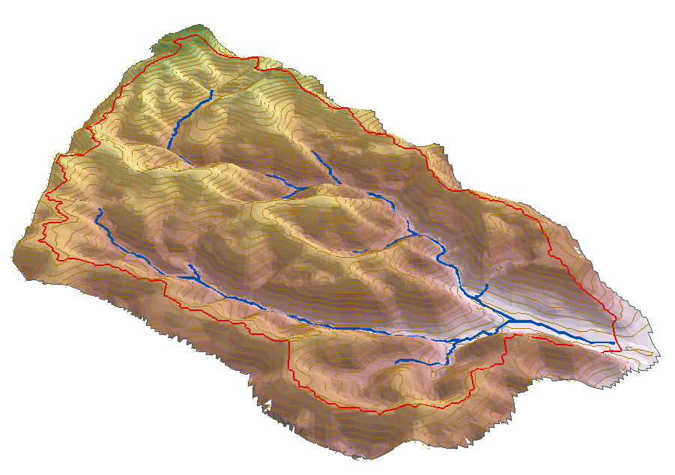
Watershed water balance
P
E+T
Q
S
G

Slide 5
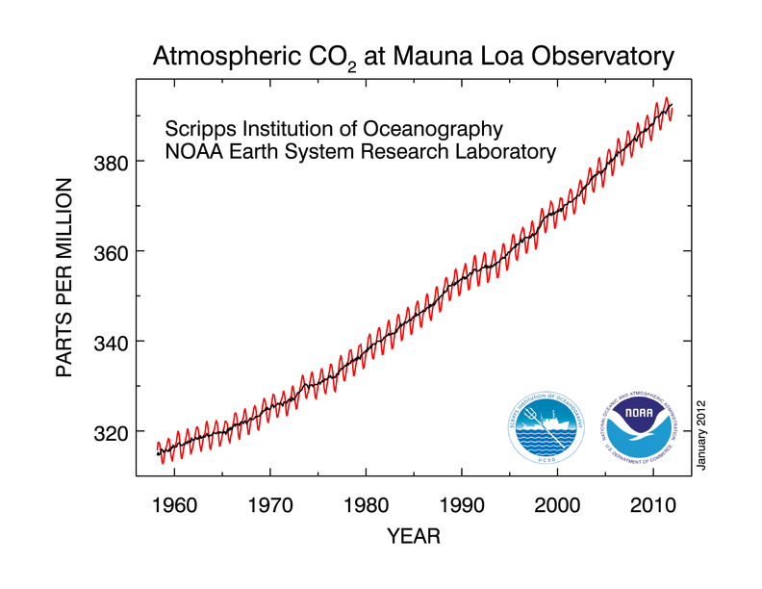
Climate Change
From http://www.esrl.noaa.gov/gmd/ccgg/trends/

Slide 6
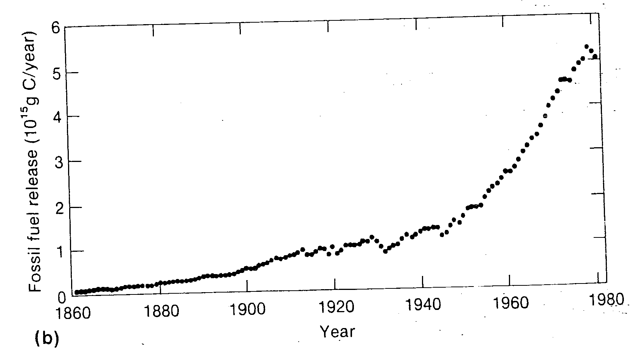
From Mitchell, Reviews of Geophysics, 1989

Slide 7
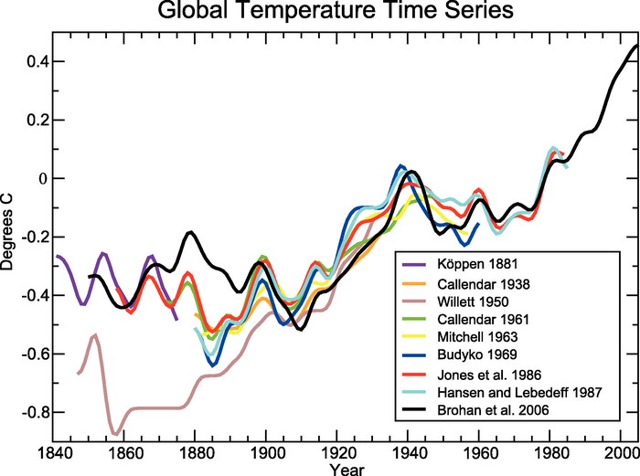
Published records of surface temperature change over large regions.
From http://www.ipcc.ch/publications_and_data/ar4/wg1/en/figure-1-3.html

Slide 8
Projected median temperature change in degrees Fahrenheit (°F) (of 112 climate projections) over the Western United States, 2070–2099 relative to 1950–1979. From (http://www.usbr.gov/climate/SECURE/docs/SECUREWaterReport.pdf)

Slide 9
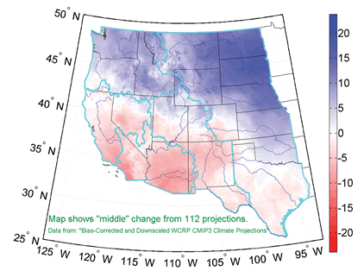
Projected median percentage precipitation change (of 112 climate projections) over the Western United States, 2070–2099 relative to 1950–1979. From (http://www.usbr.gov/climate/SECURE/docs/SECUREWaterReport.pdf)

