Slide 1
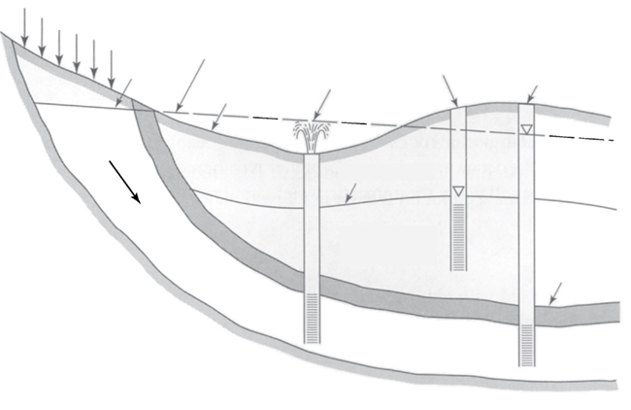
Groundwater vocabulary
A
B
C
E
D
From Mays, 2011, Ground and Surface Water Hydrology

Slide 2
Groundwater vocabulary
A
B
C
D
E
From Mays, 2011, Ground and Surface Water Hydrology

Slide 3
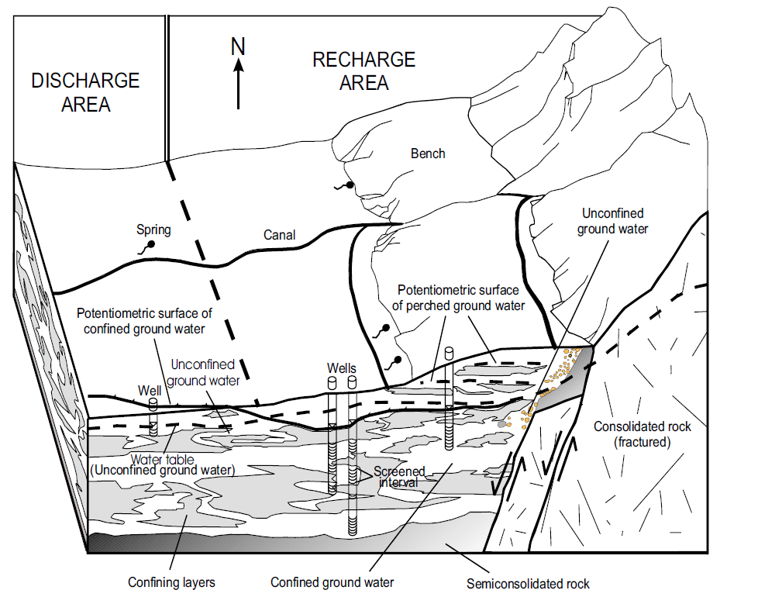
Schematic block diagram showing ground-water conditions in Cache Valley, Utah (from Kariya and others, 1994, from http://geology.utah.gov/online/mp/mp02-08/mp02-08txt.pdf).

Slide 4
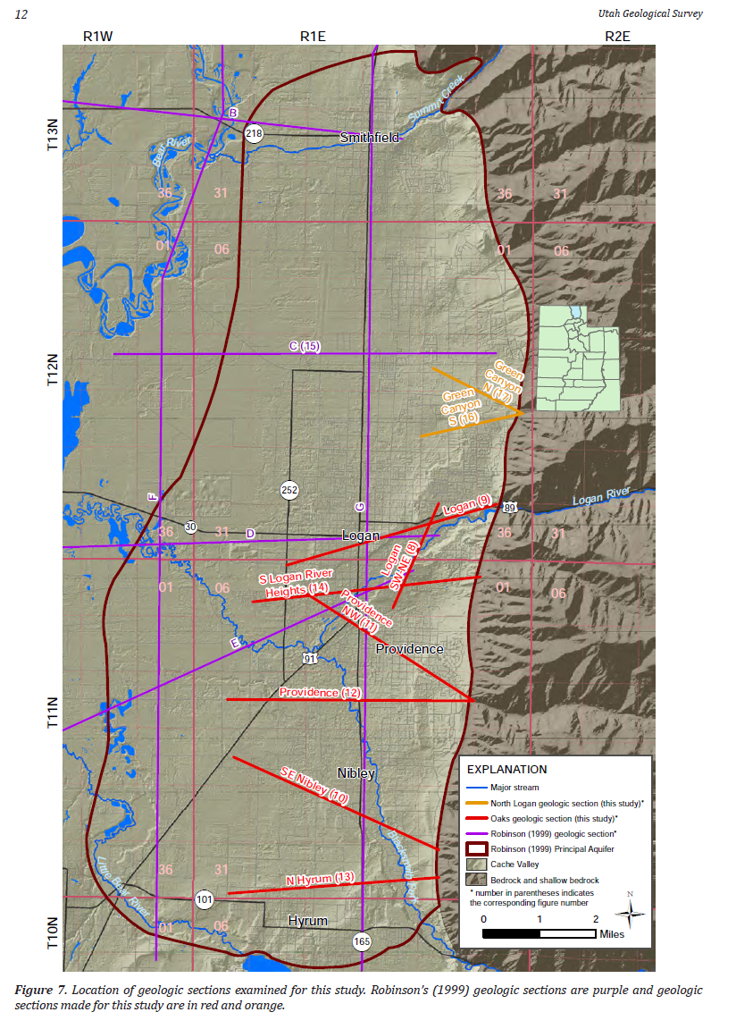
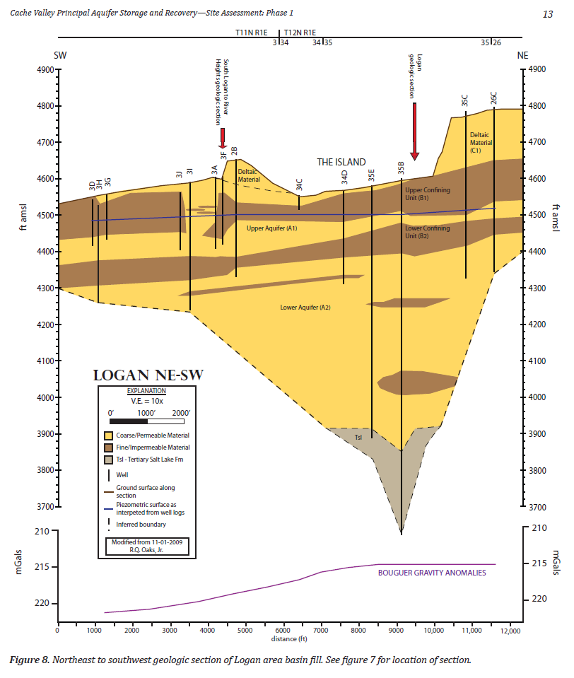
From UGS Open-File Report 579 http://geology.utah.gov/online/ofr/ofr-579.pdf

Slide 5
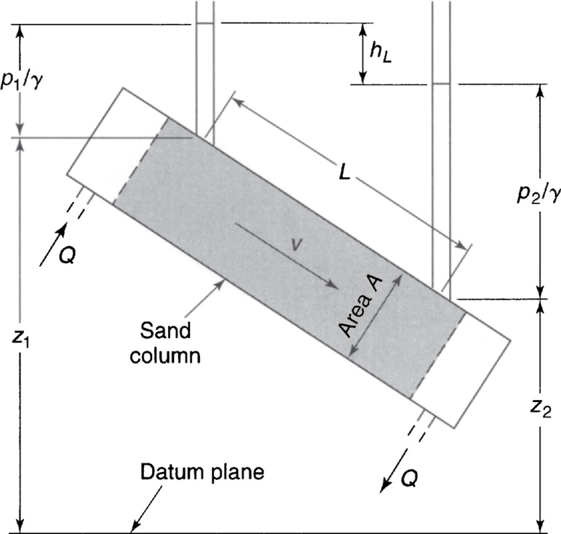
Darcy’s experiment: Pressure distribution and head loss in flow through a sand column
From Mays, 2011, Ground and Surface Water Hydrology

Slide 6
The figure shows a sample from an unconfined aquifer. L=50 cm, Diameter = 6 cm. The sample is tested for 3 min under constant head difference of 16.3 cm. 45.2 cm³ of water is collected at the outlet.
Determine the hydraulic conductivity of the sample
Determine the average interstitial velocity assuming a porosity of 0.3
Determine the Reynolds number assuming an effective grain size (d₁₀) of 0.037 cm
From Mays, 2011, Ground and Surface Water Hydrology

