Slide 1
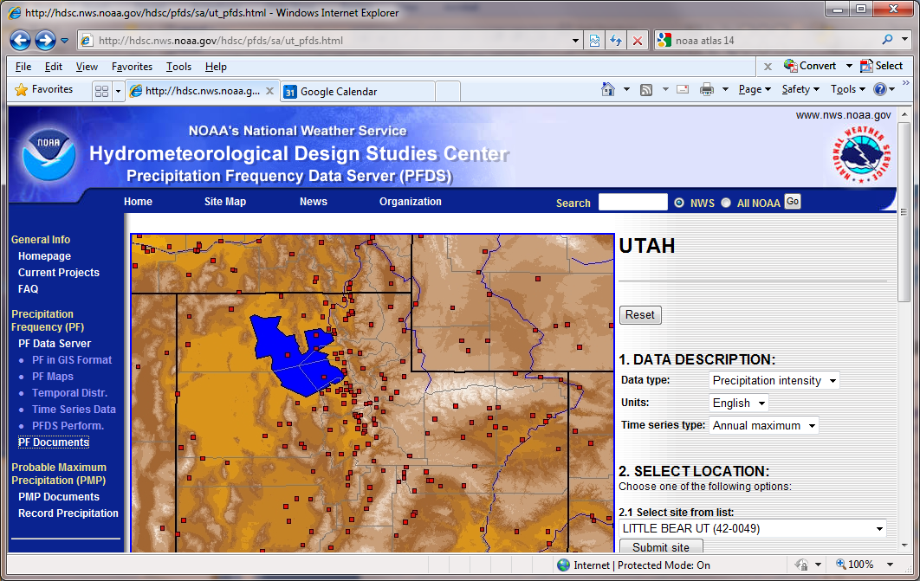
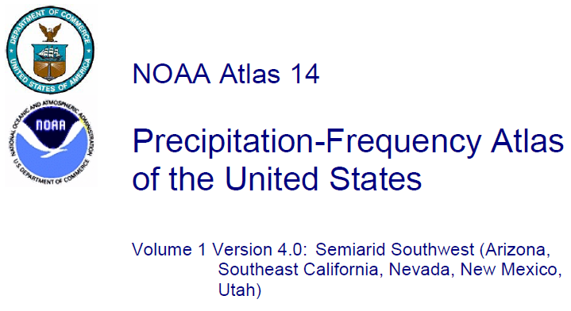
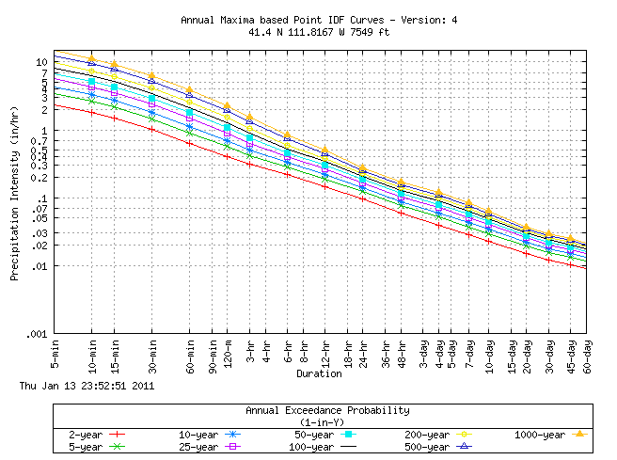
NOAA Hydrometeorological Design Studies Center Precipitation Frequency Data Server (PFDS)
http://hdsc.nws.noaa.gov/hdsc/pfds/
The standard source for design storm data

Slide 2
Terminology used in Precipitation Frequency Analysis
Duration (T_{d}). The interval over which precipitation occurs.
Intensity (i). The average precipitation rate over a specified duration
Depth (D). The total precipitation over a specified duration
Exceedance probability (P). The probability associated with exceeding a given amount in any given period (usually year) once or more than once.
Recurrence interval or Return period (T). The average interval between events of a set magnitude, evaluated as the inverse of the exceedence probability
A 50 year return period event has a 1/50 = 0.02 probability of being exceeded in any one year
Frequency. General term for specifying the average recurrence interval or annual exceedance probability.
D = i T_{d}
Rate
i
Time
T_{d}
$$P=Prob(D>d)$$
$$T=1/P$$
Annual maximum series (AMS). Time series of the largest amounts in a continuous period (usually year).
Partial duration series (PDS). Time series that includes all amounts above a pre-defined threshold regardless of year; it can include more than one event in any particular year.
Based on http://www.nws.noaa.gov/oh/hdsc/glossary.html

Slide 3
Example – Design Rainfall for Logan
What amount of rain in Logan in a 6 hr period is a 100 yr storm
What amount of rain in Logan in a 1 hr period is a 100 year storm
http://hdsc.nws.noaa.gov/hdsc/pfds/

Slide 5
From NOAA Atlas 14 (for Utah)

Slide 6
From NOAA Atlas 2 http://www.nws.noaa.gov/oh/hdsc/PF_documents/Atlas2_Volume5.pdf

Slide 7
From NOAA Atlas 2 http://www.nws.noaa.gov/oh/hdsc/PF_documents/Atlas2_Volume5.pdf

Slide 8
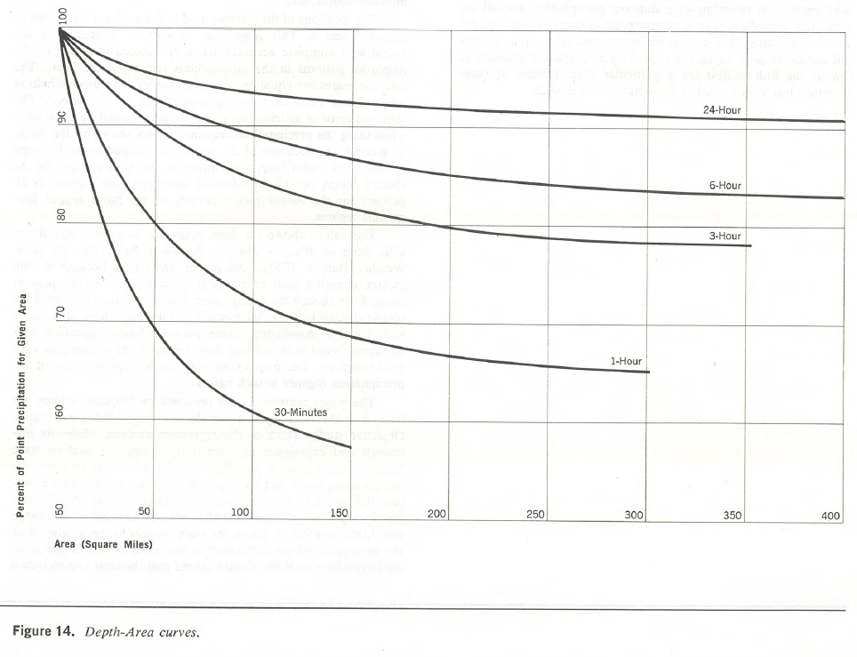
Example
Tabulated are the data from a storm within a 23,300 ha basin
Interval of isohyets (cm) | 0-2 | 2-4 | 4-6 | 6-8 | 8-10 | 10-12 | 12-14
Enclosed area (ha x 1000) | 6 | 5 | 4.1 | 3.3 | 2.5 | 1.6 | 0.8
Determine the average depth of precipitation within the basin
Develop the depth-area relationship

Slide 9
Example
Consider a rainfall event having a 5-min cumulative rainfall record given below
Time (min) | 0 | 5 | 10 | 15 | 20 | 25 | 30 | 35 | 40
Cumulative rainfall (mm) | 0 | 6 | 13 | 24 | 36 | 40 | 45 | 45 | 45
What is the duration of the entire rainfall event
What is the total amount of rainfall
Find the rainfall hyetograph with 10 min time steps (in mm/hr)
Find the maximum 10-min and 20-min average rainfall intensities (mm/hr)for this event

Slide 10
Summary
The atmosphere is the major link between oceans and continents
The hydrologic cycle is shaped by conditions in the atmosphere with precipitation as the major input
Precipitation due to atmospheric moisture, lifting, cooling, condensation, release of latent heat, instability
Precipitation variability is summarized statistically in intensity-duration-frequency curves used for design
Spatial averaging methods are used to calculate precipitation over a watershed

