Slide 1
Hydrologic Losses, Rainfall Excess, Baseflow Separation, Abstractions – The φ-Index Mays section 8.2
Learning Objectives
Separate a hydrograph into baseflow and direct runoff
Use direct runoff to determine total rainfall excess
Determine the φ index from rainfall and total rainfall excess
Determine the rainfall excess hyetograph

Slide 2
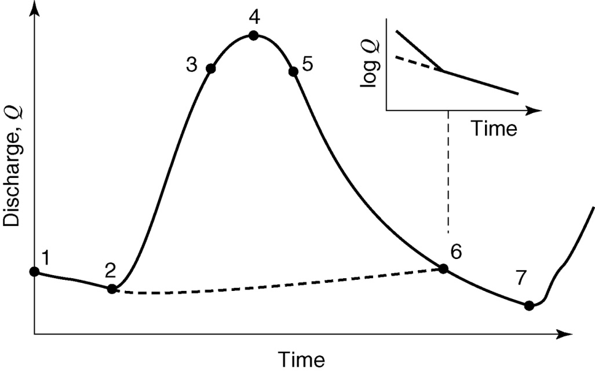
Hydrologic Losses, Rainfall Excess, Baseflow Separation, Abstractions – The φ-Index
Rainfall Excess
Direct Runoff
Direct Runoff
Baseflow
Baseflow Recession (section 8.2.1)
The φ-Index is the rate of abstractions that results in
Rainfall Excess Volume = Direct Runoff Volume
An approximation of infiltration rate
$$Q\left(t_{2}\right)=Q\left(t_{1}\right)e^{−k(t_{2}−t_{1})}$$
Direct runoff above this recession line

Slide 3
Example. Problem 8.2.3
Also determine
the volume of Baseflow
the volume of direct runoff

Slide 4
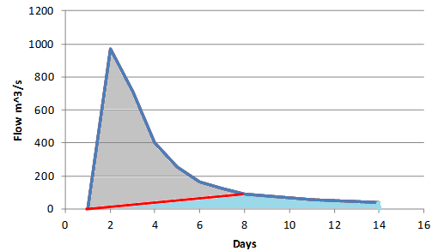
Problem 8.2.3
End of direct runoff and beginning of baseflow recession

Slide 5
Example 8.2.1 φ-Index
1.2 ha
42
Changed to be a bit more interesting
Rainfall Excess

