Slide 1
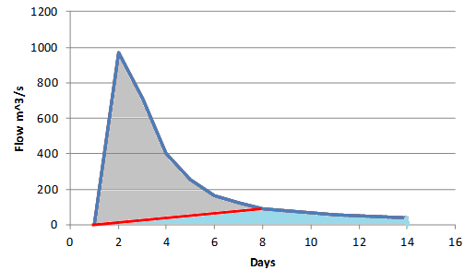
Problem 8.2.3
End of direct runoff and beginning of baseflow recession

Slide 2
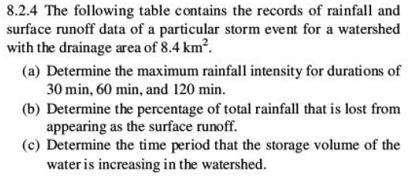
Problem 8.2.4.

Slide 3
Determining the φ index and Excess Rainfall Hyetograph

Slide 4
A D hour unit hydrograph is the characteristic response of a given watershed to a unit volume (e.g. 1 in or cm) of effective water input (usually rain) applied at a constant rate for D hours
Recap of Unit Hydrograph basics
Runoff (mm/hr)
Runoff and Flow
Flow (m³/s)
Time
Superposition is used to determine the response to variable rainfall

Slide 5
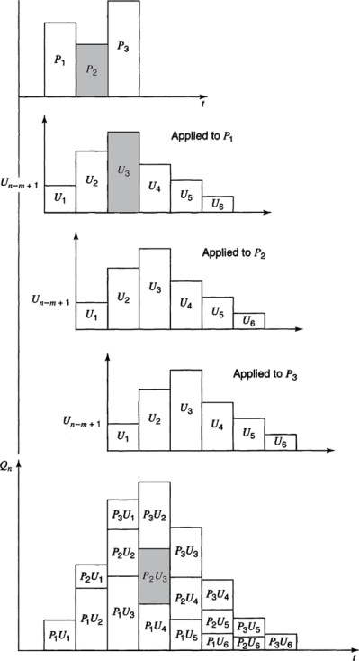
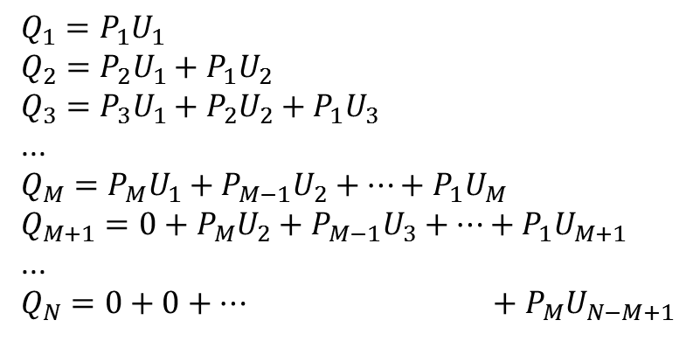
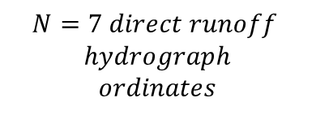
Calculating a Hydrograph from a Unit Hydrograph and visa versa
$$Q_{1}=P_{1}U_{1}$$
$$Q_{2}=P_{2}U_{1}+P_{1}U_{2}$$
$$Q_{3}=P_{3}U_{1}+P_{2}U_{2}+P_{1}U_{3}$$
...
$$Q_{M}=P_{M}U_{1}+P_{M−1}U_{2}+…+P_{1}U_{M}$$
$$Q_{M+1}=0+P_{M}U_{2}+P_{M−1}U_{3}+…+P_{1}U_{M+1}$$
...
$$Q_{N}=0+0+… +P_{M}U_{N−M+1}$$
$Q_{n}=\sum_{m=1}^{M}{P_{m}U_{n−m+1}}$ for n=1 ... N
$$M=3 precip inputs$$
$$L=5 unit hydrograph$$
$$ordinates$$
$$N=7 direct runoff$$
$$hydrograph$$
$$ordinates$$
$$N=L+M−1$$
From Mays, 2011, Ground and Surface Water Hydrology

Slide 6
Example 8.3.1

Slide 7
Determining the Unit Hydrograph from Direct Runoff Hydrograph Observations
M =4 precip values
N=9 Direct Runoff Hydrograph Ordinates
L=N=M+1=6 Unit Hydrograph ordinates
9 equations to solve for 6 U values
(Overdetermined system – use least squares with Solver)
Any 6 initial U values
Minimize this by changing these

Slide 8
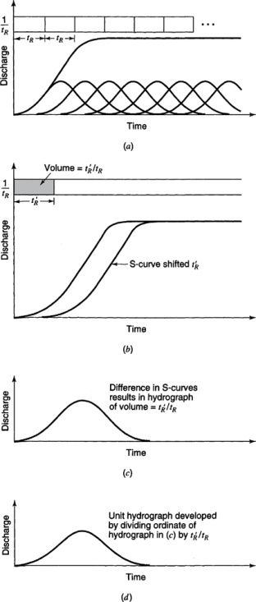
S Curves
From Mays, 2011, Ground and Surface Water Hydrology

Slide 9
S Curve to Develop 2 hr unit hydrograph

