Slide 1
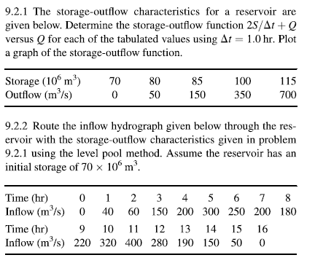
HW8 Guidance
Level Pool Routing

Slide 2
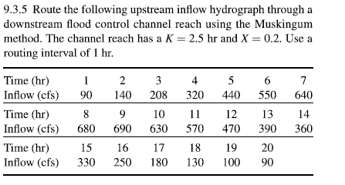
Muskingum Routing

