Slide 1
Confined aquifer storage
2.8.1 The coefficient of storage of a confined aquifer is found to be 6.8 x 10⁻⁴ as a result of a pumping test. The thickness of the aquifer is 50 m and the porosity is 0.25. Determine the fractions of the expansibility of water and compressibility of the aquifer skeleton in making up the storage coefficient of the aquifer

Slide 2
Total Stress, Fluid Pressure and Effective Stress
From http://mail.sci.ccny.cuny.edu/~pzhang/EAS44600/EAS446lec8.pdf

Slide 3
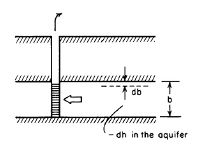
Aquifer compaction caused by groundwater pumping
From http://mail.sci.ccny.cuny.edu/~pzhang/EAS44600/EAS446lec8.pdf

Slide 4
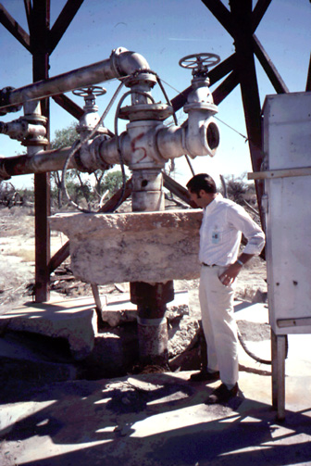
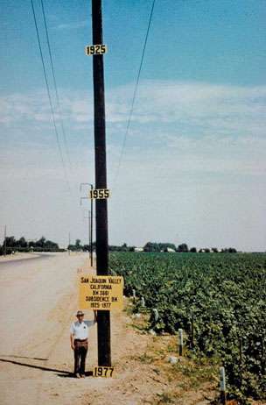
Land Subsidence due to Groundwater Pumping
A. Las Vegas Valley
B. San Joaquin Valley
From http://geochange.er.usgs.gov/sw/impacts/hydrology/vegas_gw/
From http://ga.water.usgs.gov/edu/earthgwlandsubside.html

Slide 5
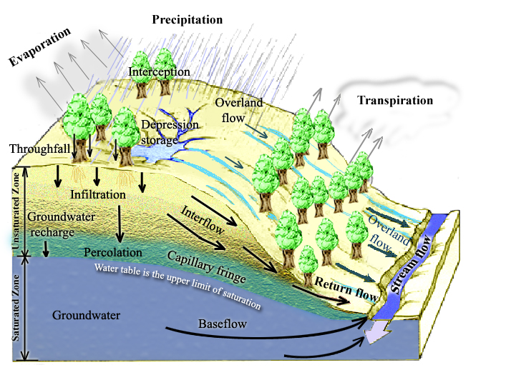
Physical Processes involved in Runoff Generation
Rainfall Runoff Processes
Notes:
Figure 1. Physical Processes involved in Runoff Generation.

Slide 6
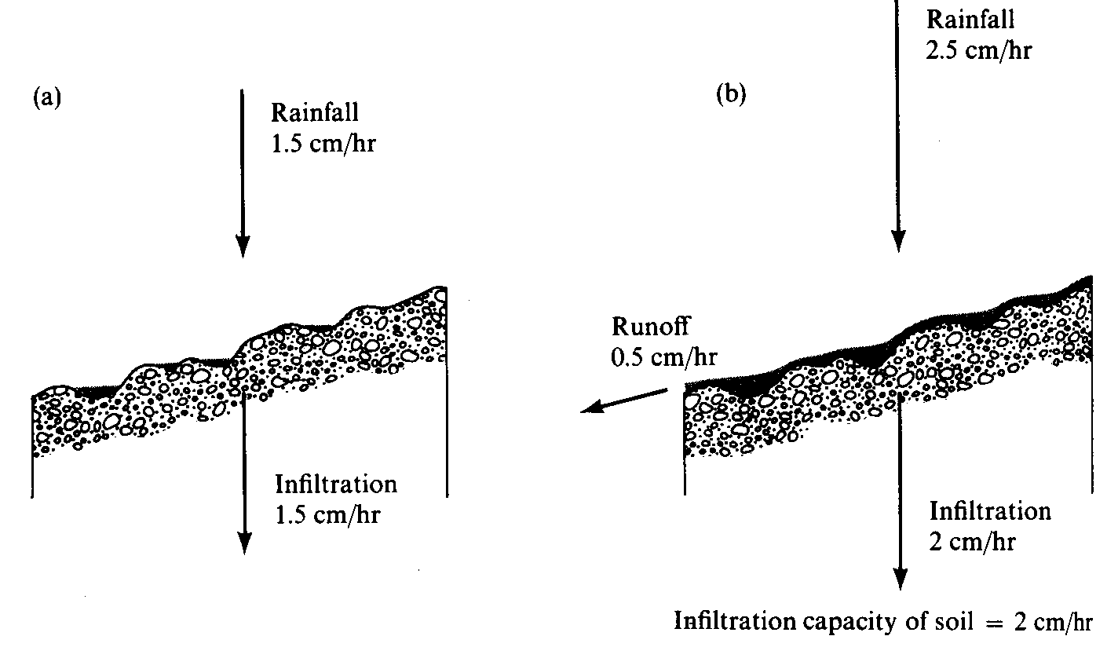
Surface Runoff occurs when surface water input exceeds infiltration capacity. (a) Infiltration rate = rainfall rate which is less than infiltration capacity. (b) Runoff rate = Rainfall intensity – Infiltration capacity. (from Dunne and Leopold, 1978)

Slide 7
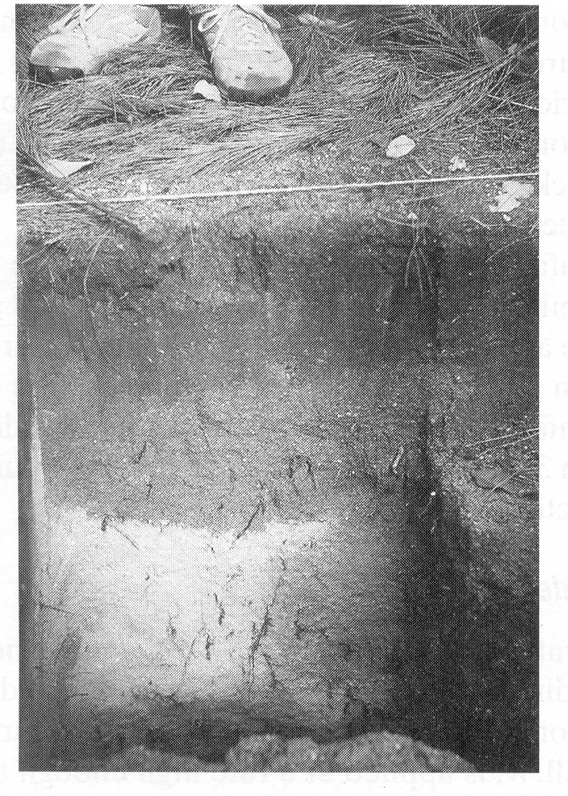
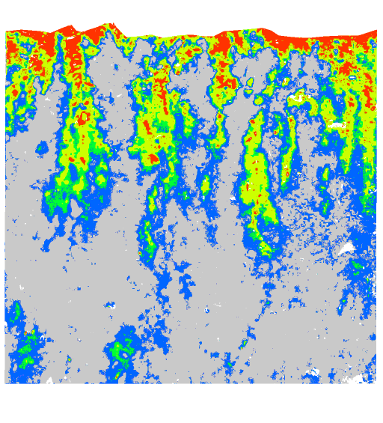
Wetting front in a sandy soil exposed after intense rain (from Dingman, 1994).
Preferential pathway infiltration (Markus Weiler, ETH Zurich)

Slide 8
Continuity equation in an unsaturated porous medium.
Δθ Δx Δy Δz =
(q Δx Δy – (q+Δq) Δx Δy) Δt

Slide 9
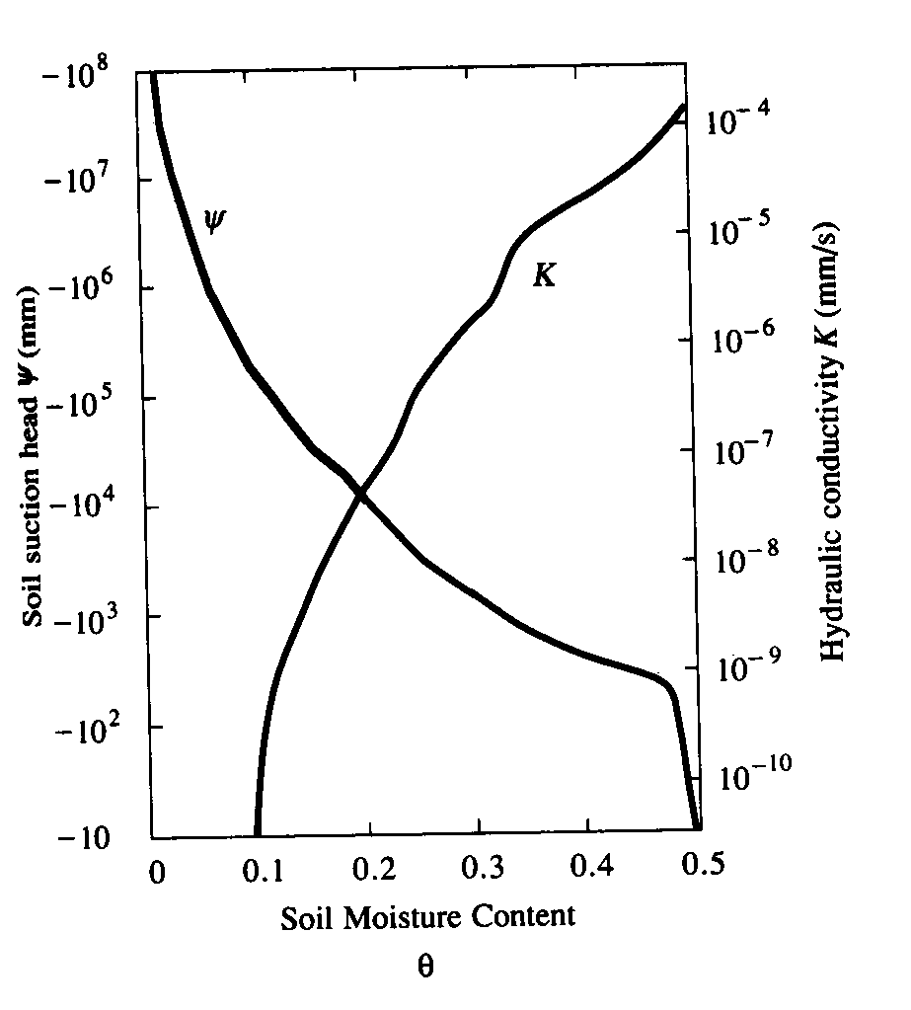
Variation of soil suction head, |ψ|, and hydraulic conductivity, K, with moisture content. (from Chow et al, 1988)

