Slide 1
Aquifer Anisotropy and general flow equations
Objective
To be able to quantify the anisotropy of an aquifer due to layering
To be able to describe the equations used in general groundwater flow calculations

Slide 2
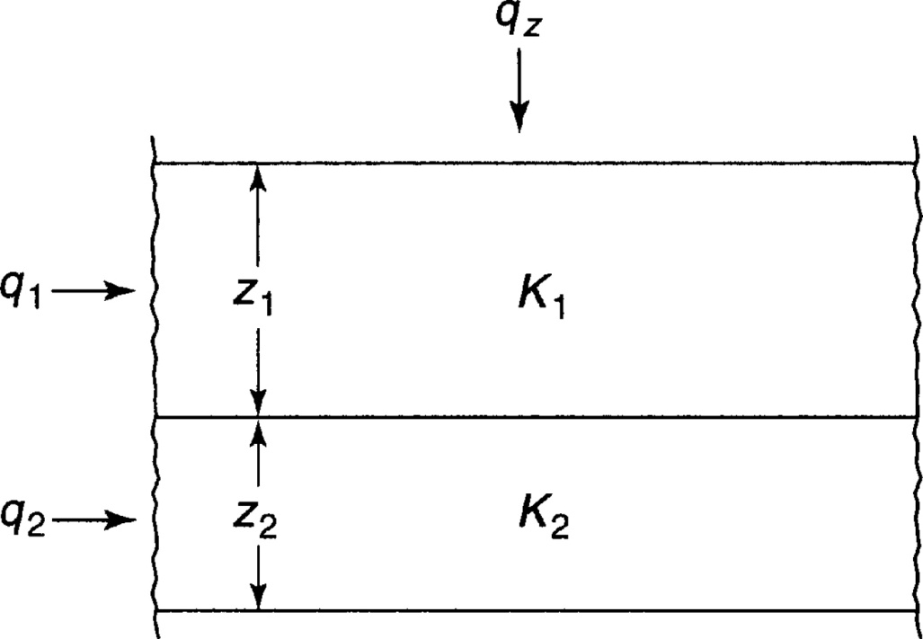
Anisotropy
From Mays, 2011, Ground and Surface Water Hydrology

Slide 3
Example
An aquifer has 3 layers with K values indicated. Compute the equivalent horizontal and vertical hydraulic conductivities
10 m
K=11.6 m/day
4.4 m
K=4.5 m/day
6.2 m
K=2.2 m/day

Slide 4
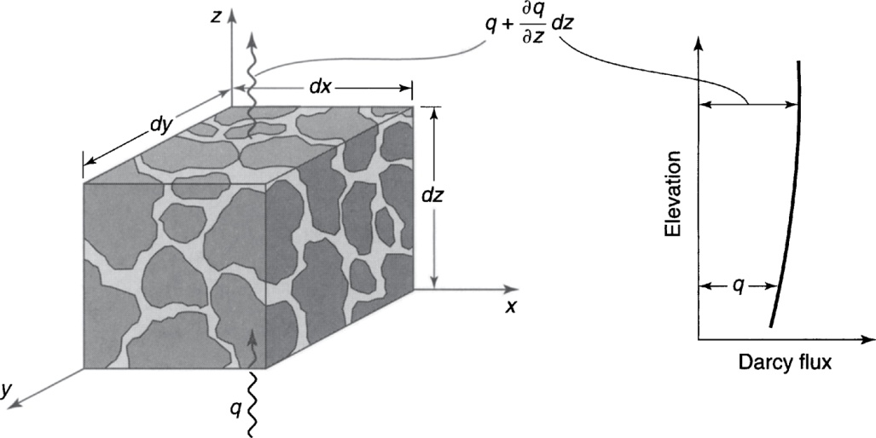
General Groundwater Flow Equations
From Mays, 2011, Ground and Surface Water Hydrology

Slide 5
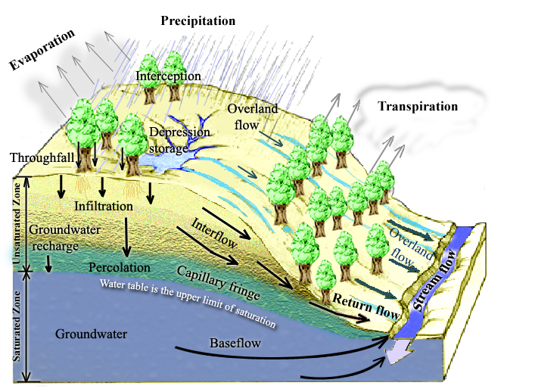
Physical Processes involved in Runoff Generation
Rainfall Runoff Processes
Notes:
Figure 1. Physical Processes involved in Runoff Generation.

Slide 6
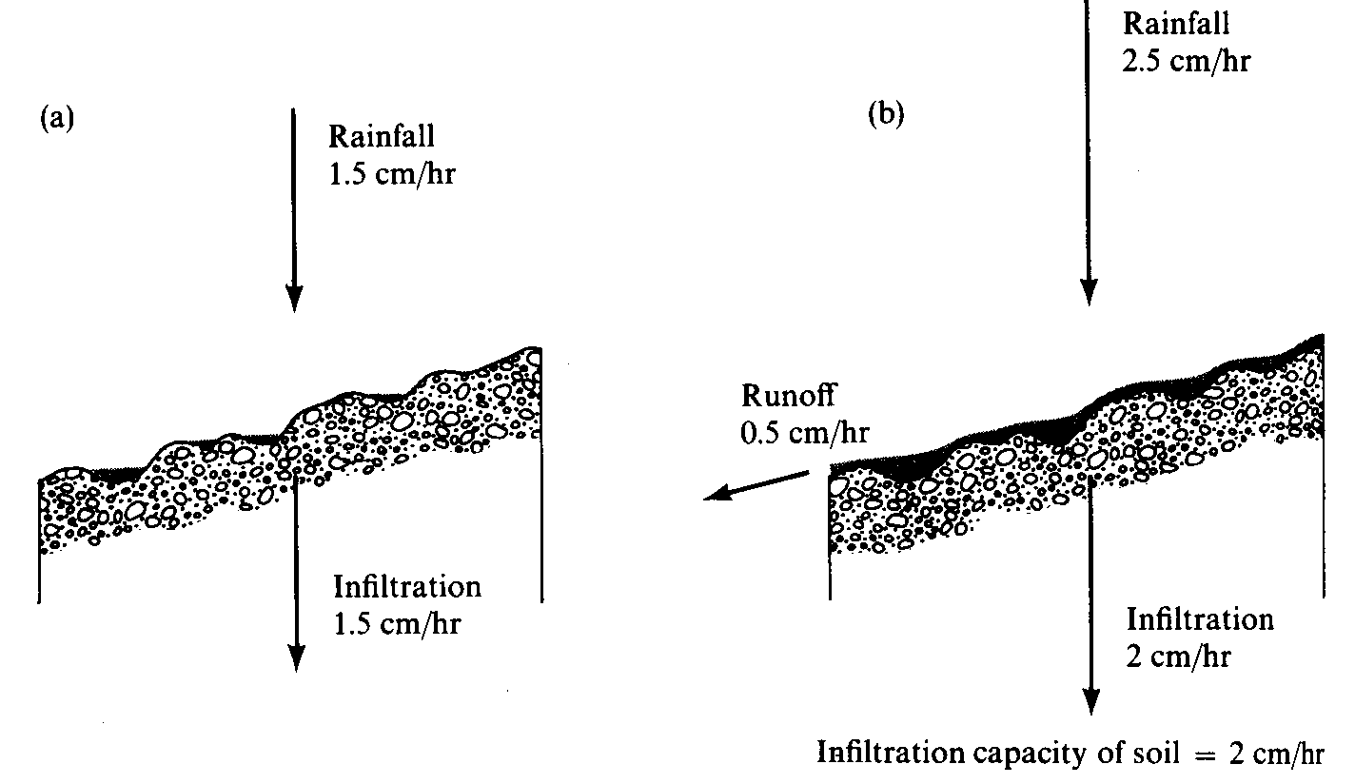
Surface Runoff occurs when surface water input exceeds infiltration capacity. (a) Infiltration rate = rainfall rate which is less than infiltration capacity. (b) Runoff rate = Rainfall intensity – Infiltration capacity. (from Dunne and Leopold, 1978)

Slide 7
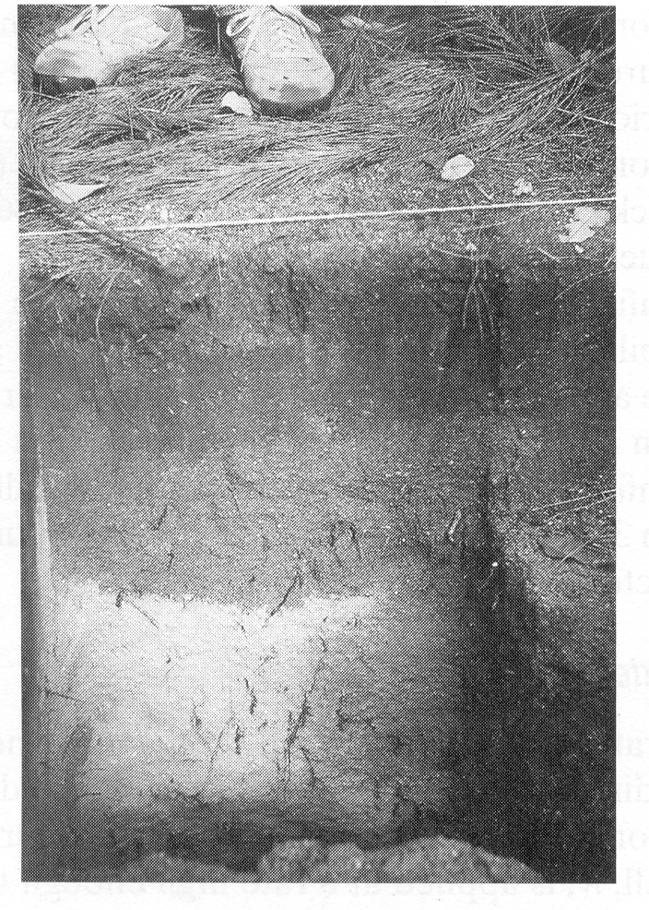
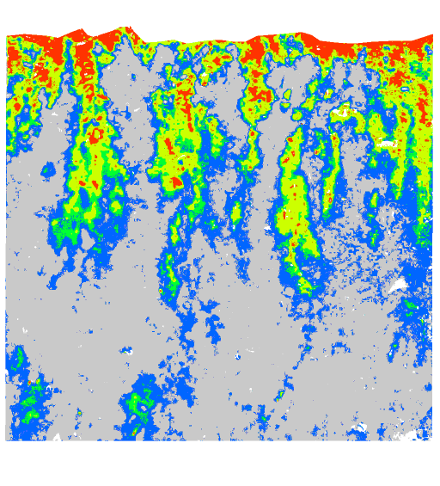
Wetting front in a sandy soil exposed after intense rain (from Dingman, 1994).
Preferential pathway infiltration (Markus Weiler, ETH Zurich)

Slide 8
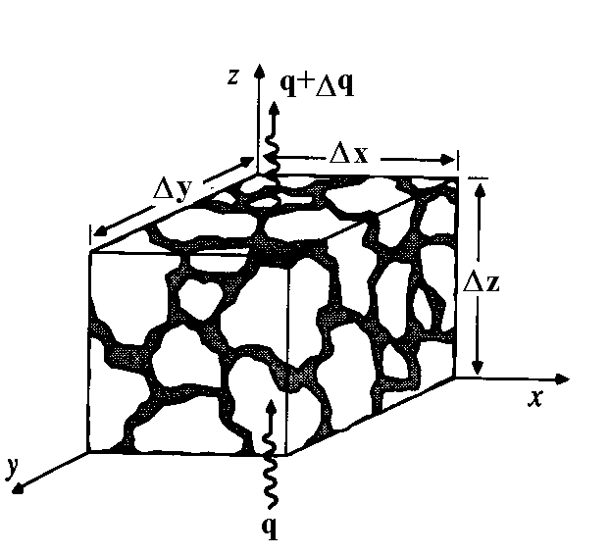
Continuity equation in an unsaturated porous medium.
Δθ Δx Δy Δz =
(q Δx Δy – (q+Δq) Δx Δy) Δt

Slide 9
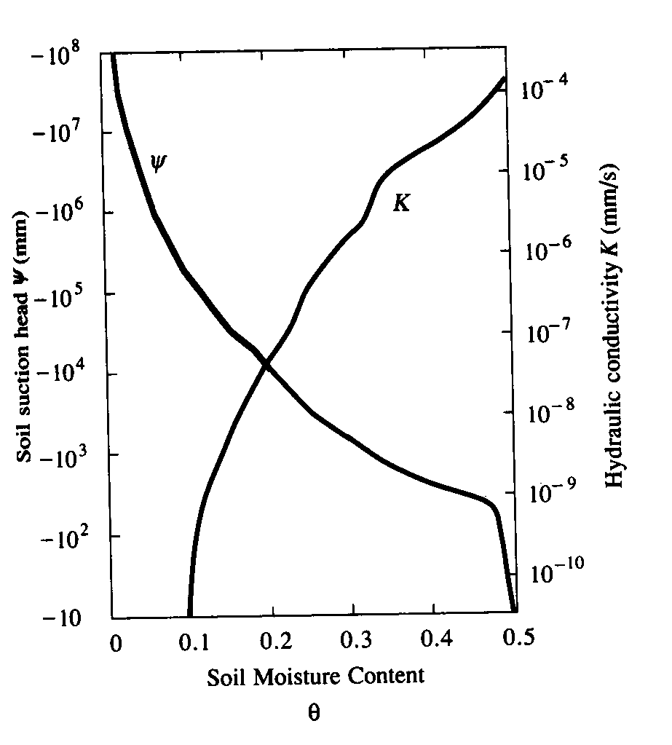
Variation of soil suction head, |ψ|, and hydraulic conductivity, K, with moisture content. (from Chow et al, 1988)

Slide 10
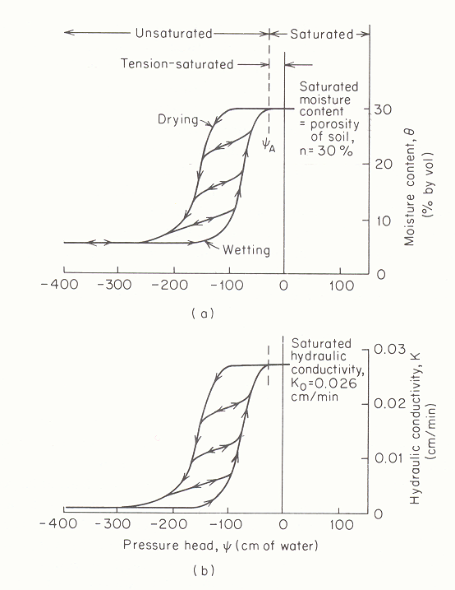
Residual moisture content θ_{r} =5%
Characteristic curve relating moisture content to pressure head (from Freeze and Cherry, 1979).

Slide 11
Characteristic curve relating Hydraulic Conductivity to pressure head (from Freeze and Cherry, 1979).

Slide 12
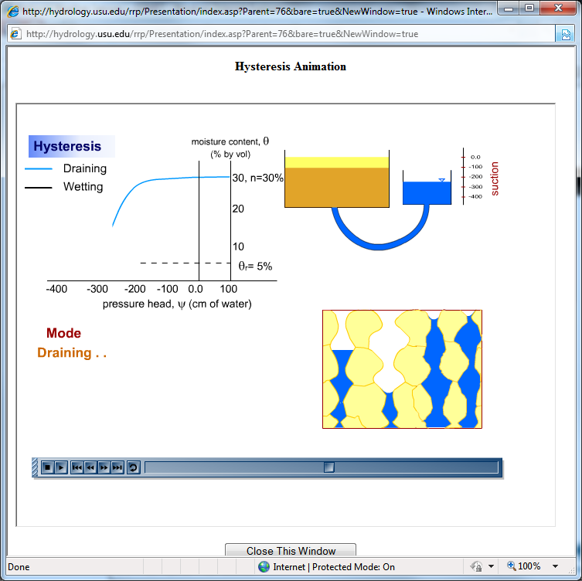
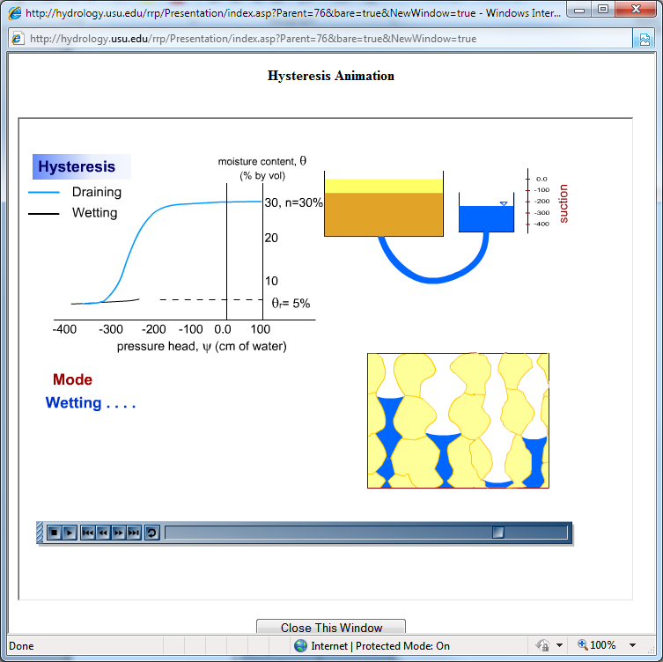
Basis for Hysteresis
See http://hydrology.usu.edu/rrp/ hysteresis animation

Slide 13
Equations to representing soil water characteristic functions
Brooks and Corey (1966)
Clapp and Hornberger (1978)
van Genuchten (1980)
See also table 3.7.1 in Mays 2011

