Slide 1
Determining Hydraulic Conductivity
Objective
To be able to calculate the hydraulic conductivity of a sample given measurements from a permeameter
To be able to estimate hydraulic conductivity from a tracer test and describe limitations of this method
To be able to quantify the anisotropy of an aquifer due to layering

Slide 2
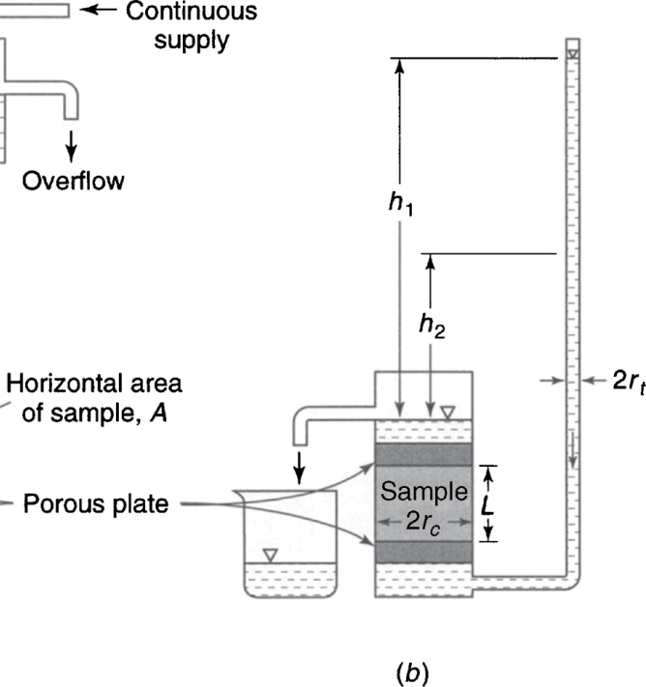
Falling Head Permeameter
A 20-cm long sample of silty fine sand with diameter of 10 cm is tested. The falling head tube has a diameter of 3 cm and the initial head is 8 cm. Over a period of 8 hr, the head in the tube falls to 1 cm. Estimate the hydraulic conductivity.
From Mays, 2011, Ground and Surface Water Hydrology

Slide 3
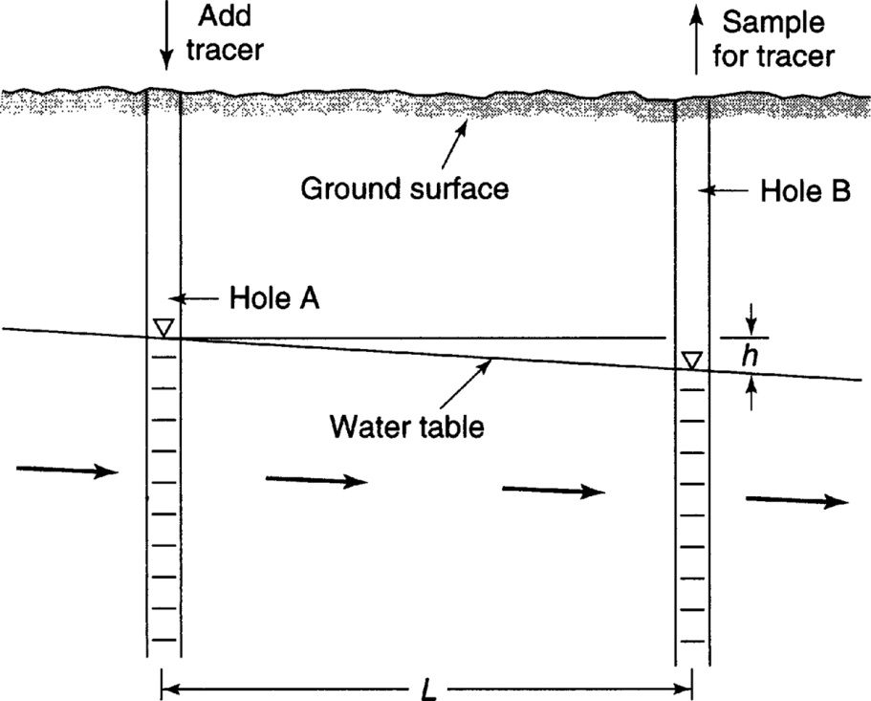
Tracer Test
The water level in two observation wells 20 m apart are 18.4 and 17.1 m. The tracer injected in the first well arrives at the second observation well in 167 hr. Compute the hydraulic conductivity given that the porosity is 0.25
From Mays, 2011, Ground and Surface Water Hydrology

Slide 4
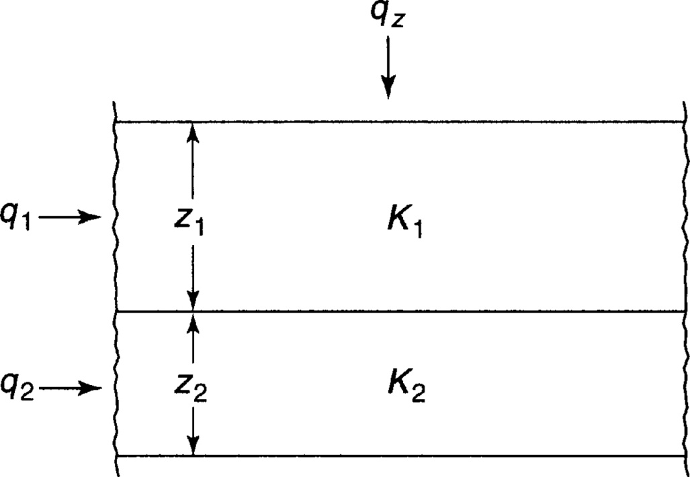
Anisotropy
From Mays, 2011, Ground and Surface Water Hydrology

