Slide 1
Spring Runoff
And the Spring Runoff Conference

Slide 2
http://wetwater.usu.edu

Slide 3
Class Wednesday March 30 ?? You are encouraged to attend the conference Talks of interest to this class
Tuesday March 29, 8:30. Brian McInerney, Hydrologist, National Weather Service, 2010-2011 Winter Snowpack and 2011 Spring Runoff Forecast
Tuesday March 29, 9:00. John Braden, University of Illinois, Integrating Human Dimensions in Integrated Water Science Research
Tuesday March 29, 16:00. Kevin Werner, Incorporating NCEP weather and climate predictions into operational ensemble streamflow forecasts for the Colorado River Basin
Wednesday March 30, 10:00. Bill Young, Water Quality Issues Facing Municipalities
Wednesday March 30, 13:30. Kristen Yeager, A new online resource for water supply enthusiasts
Wednesday March 30, 13:50. Michael Hobbins, Forecasting Evaporative Demand Across the Conterminous US

Slide 4
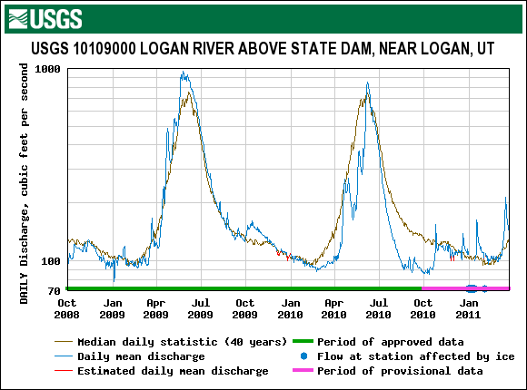
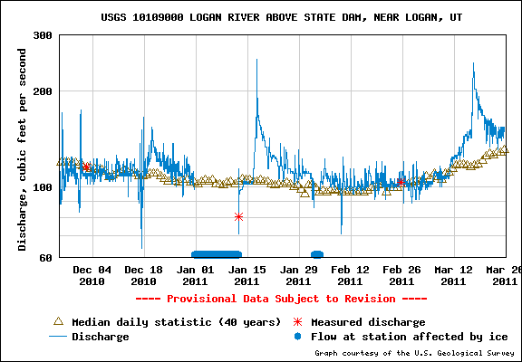
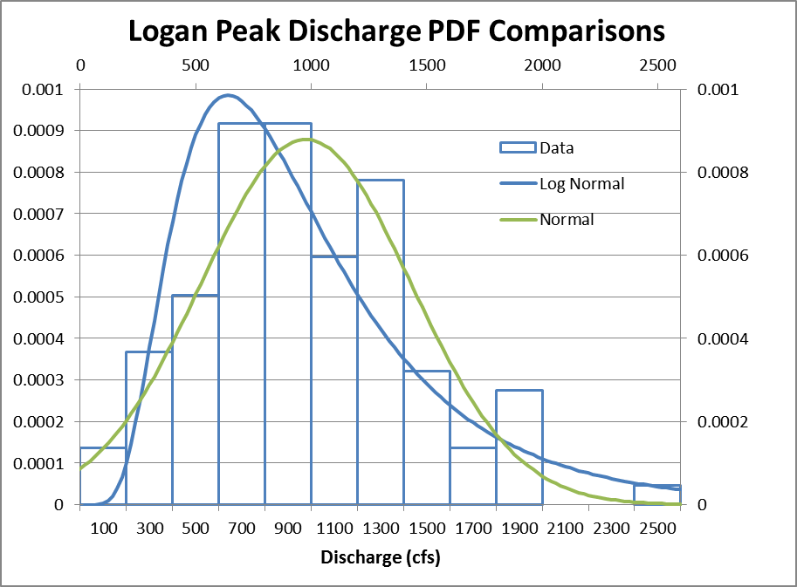
What will the streamflow be this Spring?
From http://waterdata.usgs.gov/nwis/
2450 cfs in 1907
2000 cfs in 1916
1980 cfs in 1899
1980 cfs in 1984
1970 cfs in 1986

Slide 5
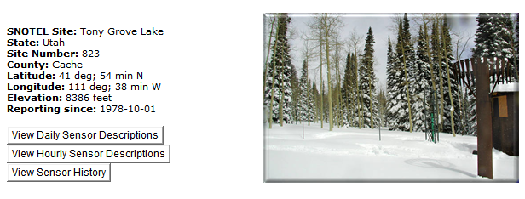
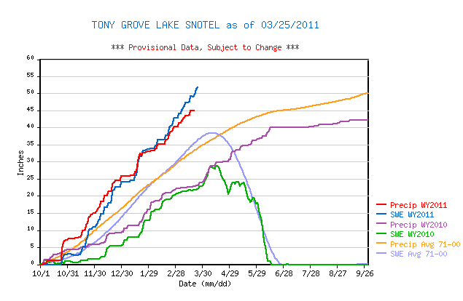
SNOTEL Data
From http://www.wcc.nrcs.usda.gov/snow/

Slide 6
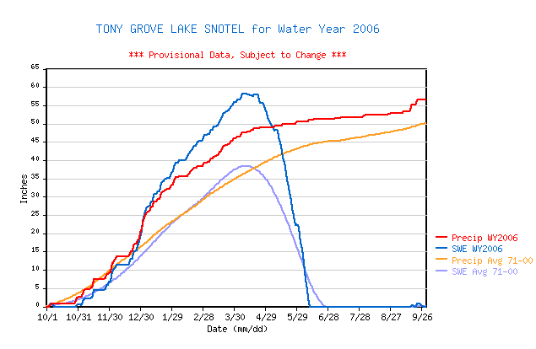
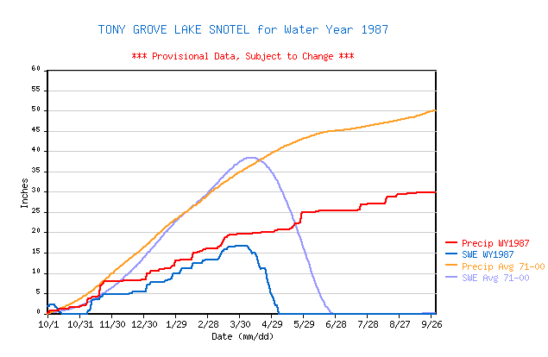
Years with Highest and lowest 3/25 snow water equivalent measurements
From http://www.wcc.nrcs.usda.gov/snow/

Slide 7
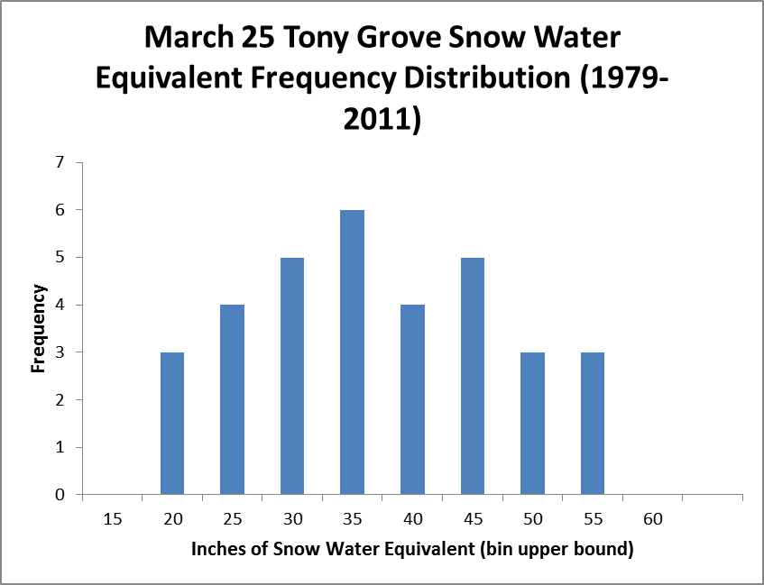

Slide 8
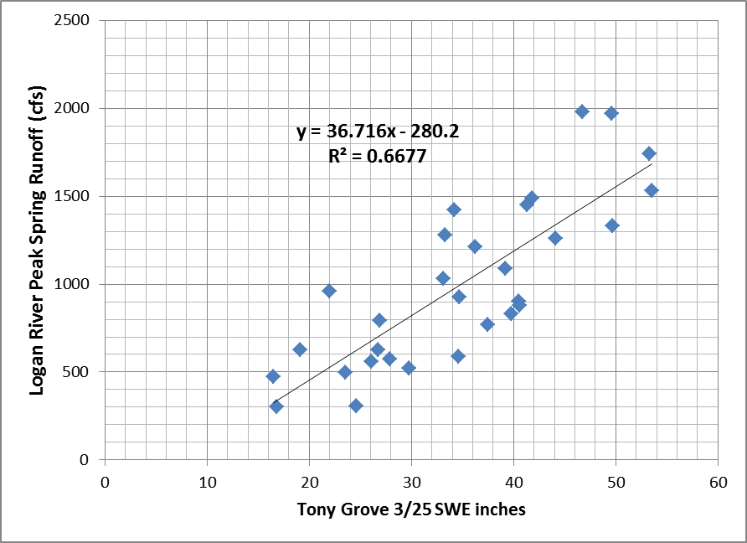
Quick 2011 Peak Runoff Prediction 1622 +- 540 cfs (95% confidence interval)
X=51.8 in
Y=1622 cfs
Var of Y 219657 cfs²
MSE = (1-R²)Var
RMSE = 270 (1 std dev error)
95% CI = 2 RMSE
=+-540 cfs
2450 cfs in 1907
2000 cfs in 1916
1980 cfs in 1899
1980 cfs in 1984
1970 cfs in 1986

