Slide 1
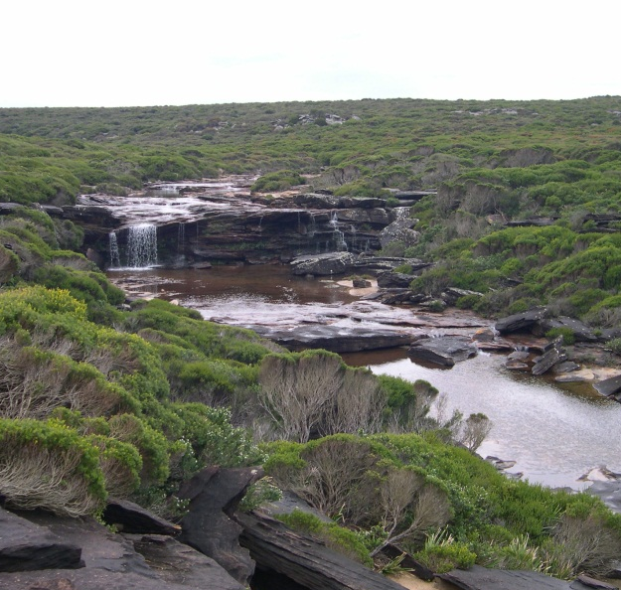
Flood Routing
Learning Objectives (Bedient et al, Chapter 4)
Be able to calculate the outflow hydrograph from the inflow hydrograph to either a reservoir or river reach
Approach
Hydrologic Routing uses the continuity equation to relate inflows, outflows and storage to solve for outflows
Simpler, more empirical, parameters estimated at application scale from experience and data
Hydraulic Routing uses continuity and momentum to solve open channel flow equations
More complex, while elegant mathematically, often requires information on flow geometry that is difficult to obtain or not available
We will only cover Hydrologic Routing (P241-268, 294-298 – Muskingham Cunge)

Slide 2
Hydrologic Reservoir Routing
Continuity
$$\frac{dS}{dt}=I−Q$$
Given I(t) and Initial S or Q, solve for S(t) and hence Q(t)
Storage Indicator (Puls) method
Runga-Kutta Method
S=f(H)
Q=f(H)
Q=f(S)
Adapted from Bedient, et al., 2008

Slide 3
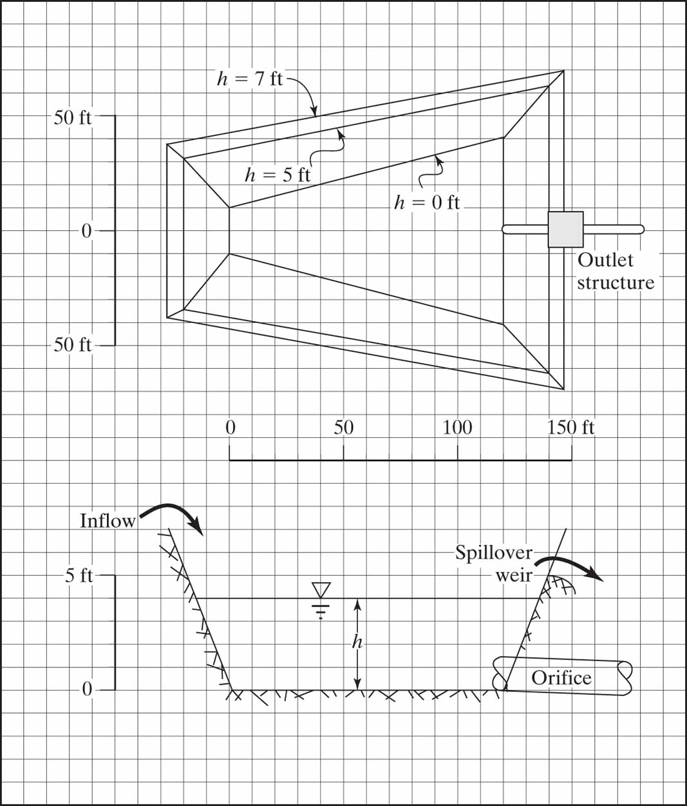
Figure E4-5b

Slide 4
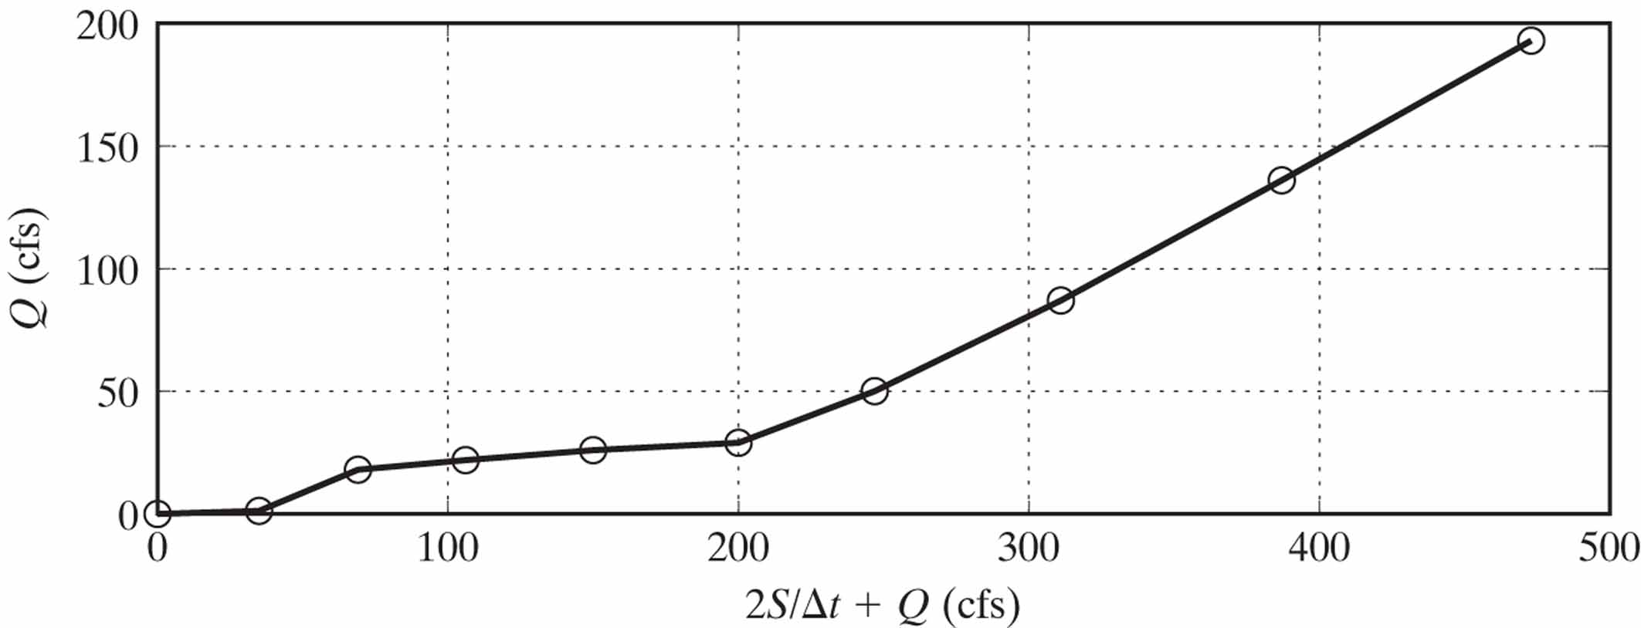
Figure E4-5c

Slide 5
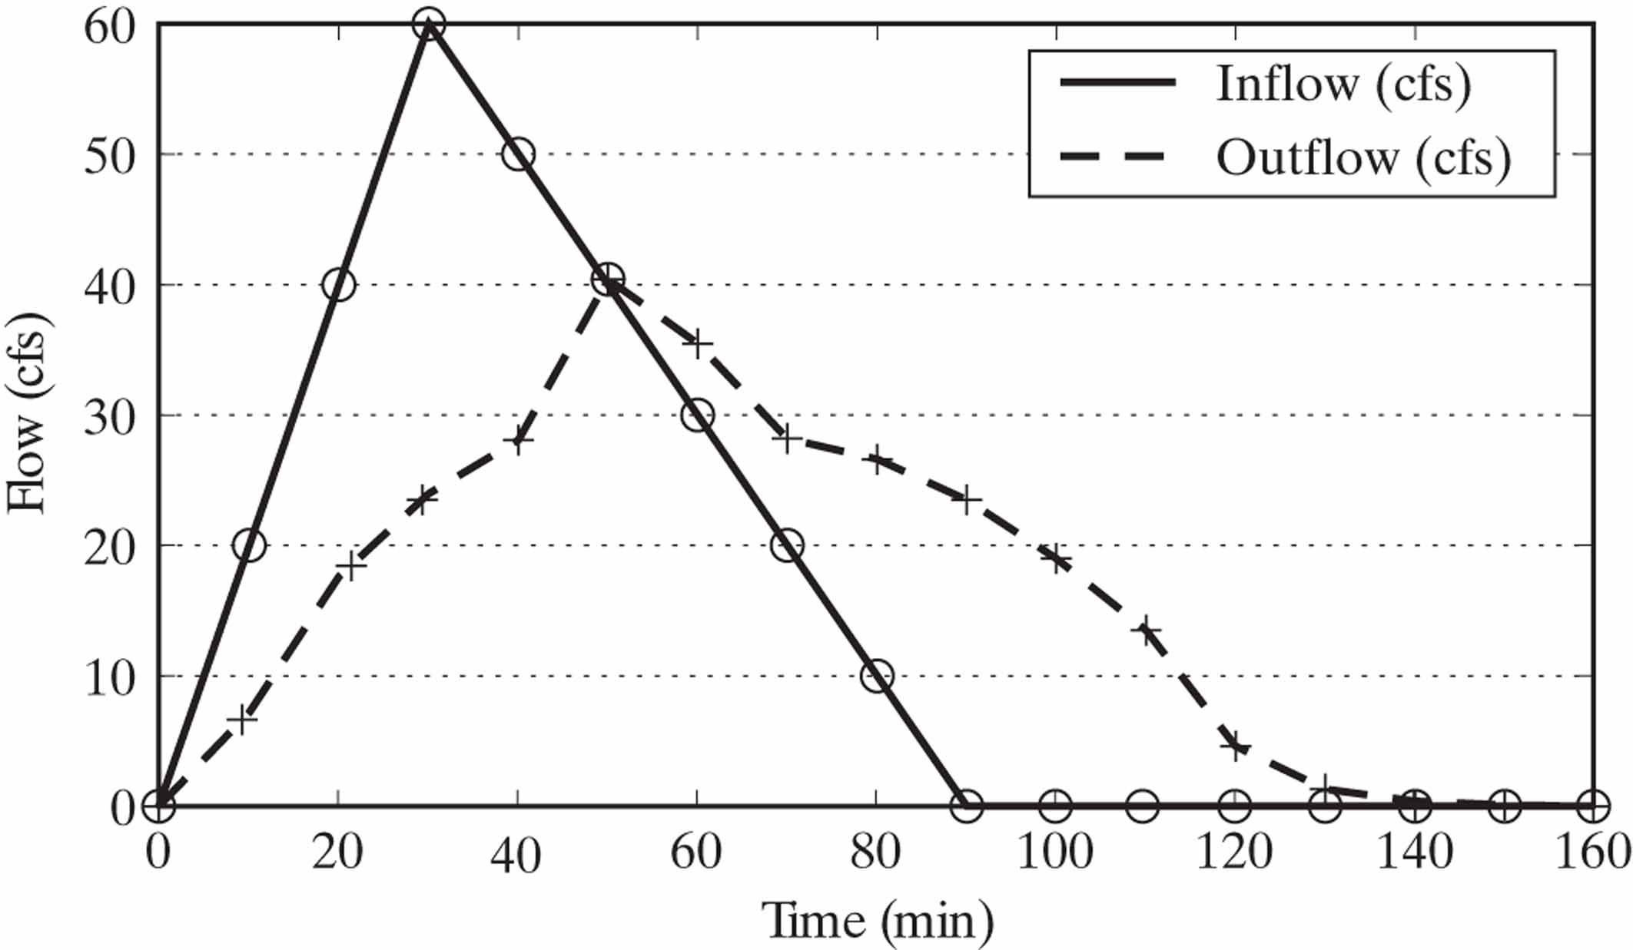
Figure E4-5a

Slide 6
Hydrologic River Routing
Continuity
$$\frac{dS}{dt}=I−Q$$
$$\frac{S_{2}−S_{1}}{Δt}=\frac{1}{2}\left(I_{1}+I_{2}\right)−\frac{1}{2}(Q_{1}+Q_{2})$$
Storage Relation
$$S=K\left[xI+\left(1−x\right)Q\right]$$
⇒$Q_{2}=C_{0}I_{2}+C_{1}I_{1}+C_{2}Q_{1}$

Slide 7
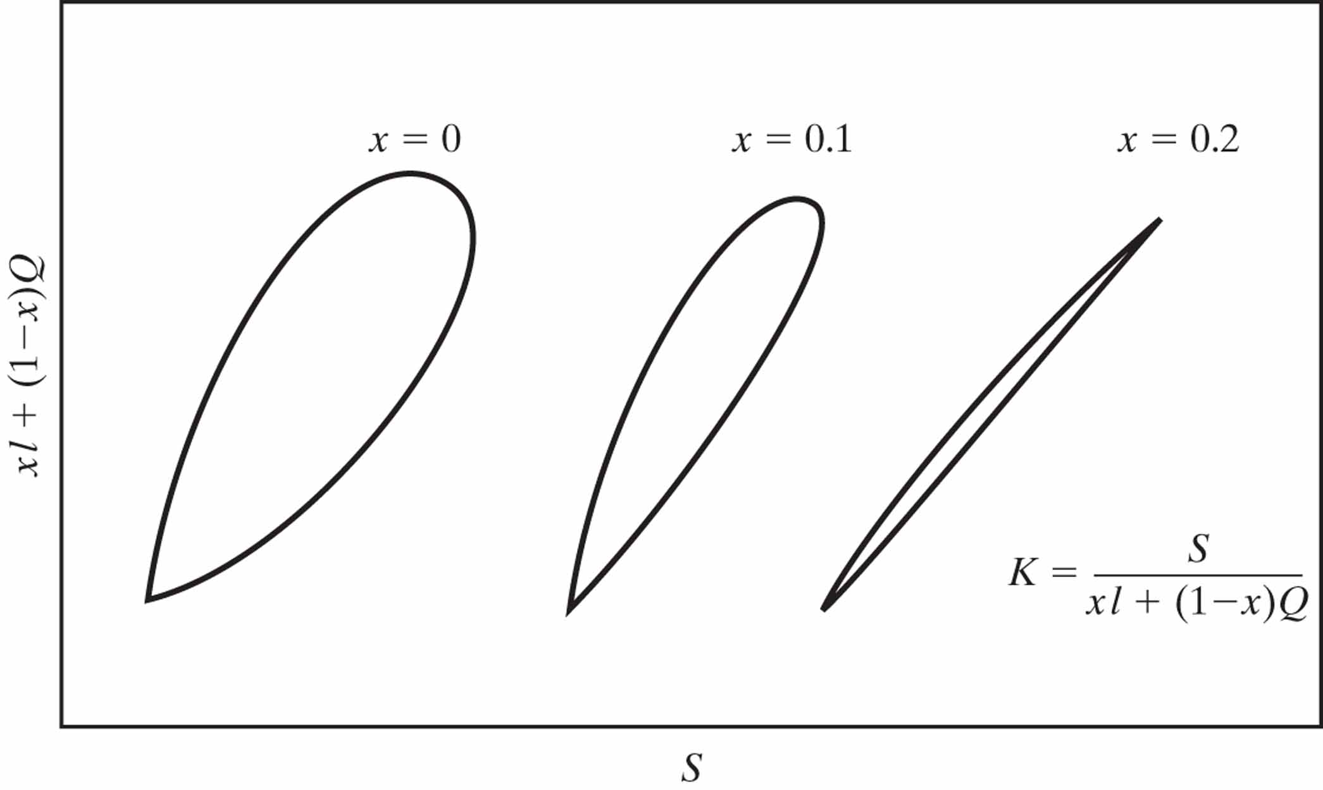
Figure 4-4
Determination of Storage Coefficients

