Slide 1
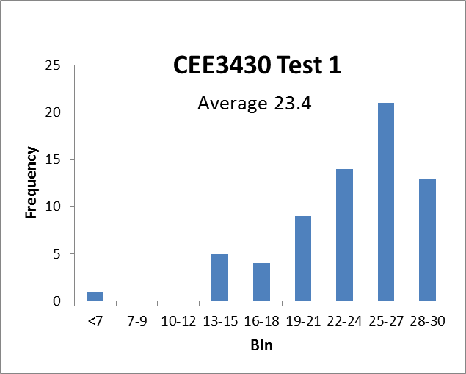

Slide 2
Frequency Analysis
Learning Objectives (Bedient et al, Chapter 3)
Quantitatively describe inherently random quantities using the methods of probability and statistics
Plot random data using a relative frequency histogram, cumulative frequency histogram and probability plot
Use the method of moments to fit a probability distribution
Use frequency analysis to calculate flood flows of a given return period
Calculate the probability and risk associated with hydrologic events

Slide 3
A random variable X is a variable whose outcomes (values) are governed by the laws of chance.
Discrete Values
Probability Mass Function
P_{X}(x)=Pr(X=x)

Slide 4
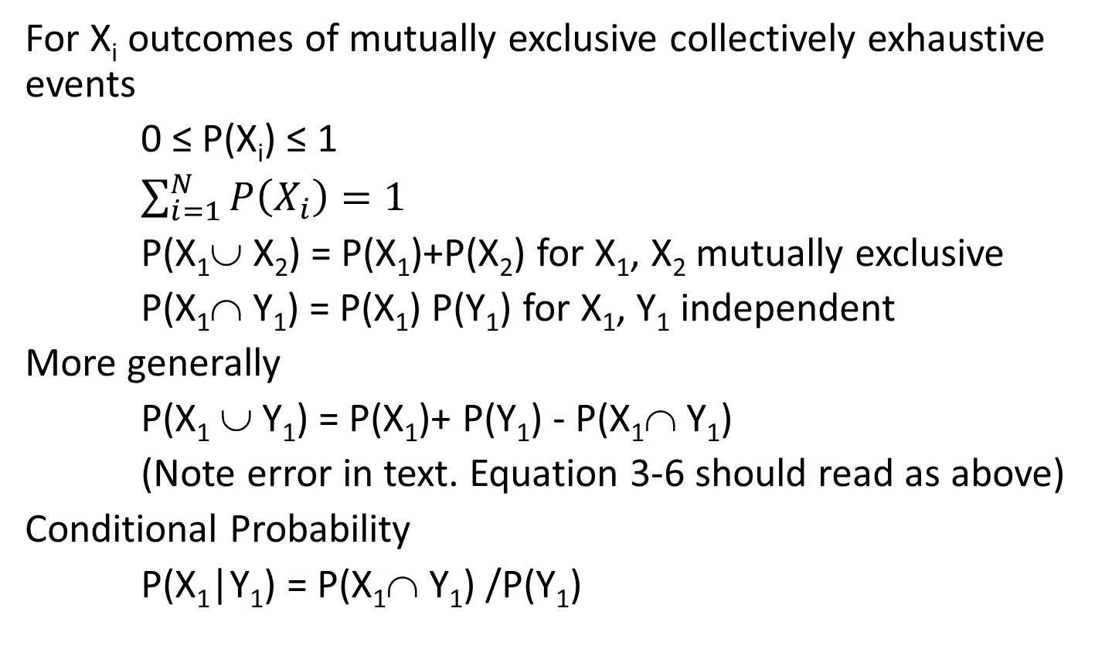
Probability Concepts
For X_{i} outcomes of mutually exclusive collectively exhaustive events
0 ≤ P(X_{i}) ≤ 1
$\sum_{i=1}^{N}{P\left(X_{i}\right)=1}$
P(X₁∪ X₂) = P(X₁)+P(X₂) for X₁, X₂ mutually exclusive
P(X₁∩ Y₁) = P(X₁) P(Y₁) for X₁, Y₁ independent
More generally
P(X₁ ∪ Y₁) = P(X₁)+ P(Y₁) - P(X₁∩ Y₁)
(Note error in text. Equation 3-6 should read as above)
Conditional Probability
P(X₁|Y₁) = P(X₁∩ Y₁) /P(Y₁)

Slide 5
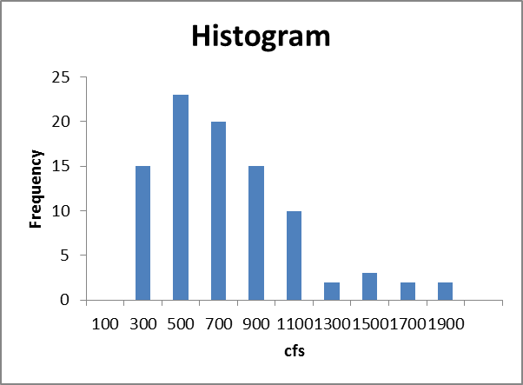
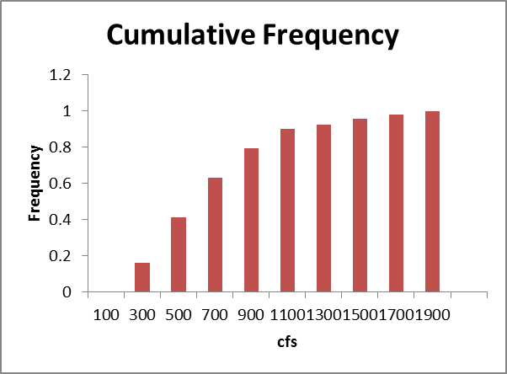
Blacksmith Fork River example
BlacksmithForkPeak.txt
What is the probability distribution to describe this data
What are the parameters of the distribution
What is the 50 year and 100 year flood

Slide 6
Numerical Quantities

Slide 7
Continuous Variable
Probability density function

Slide 8
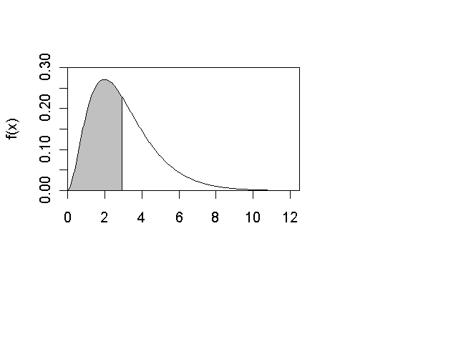
Cumulative distribution function

Slide 9
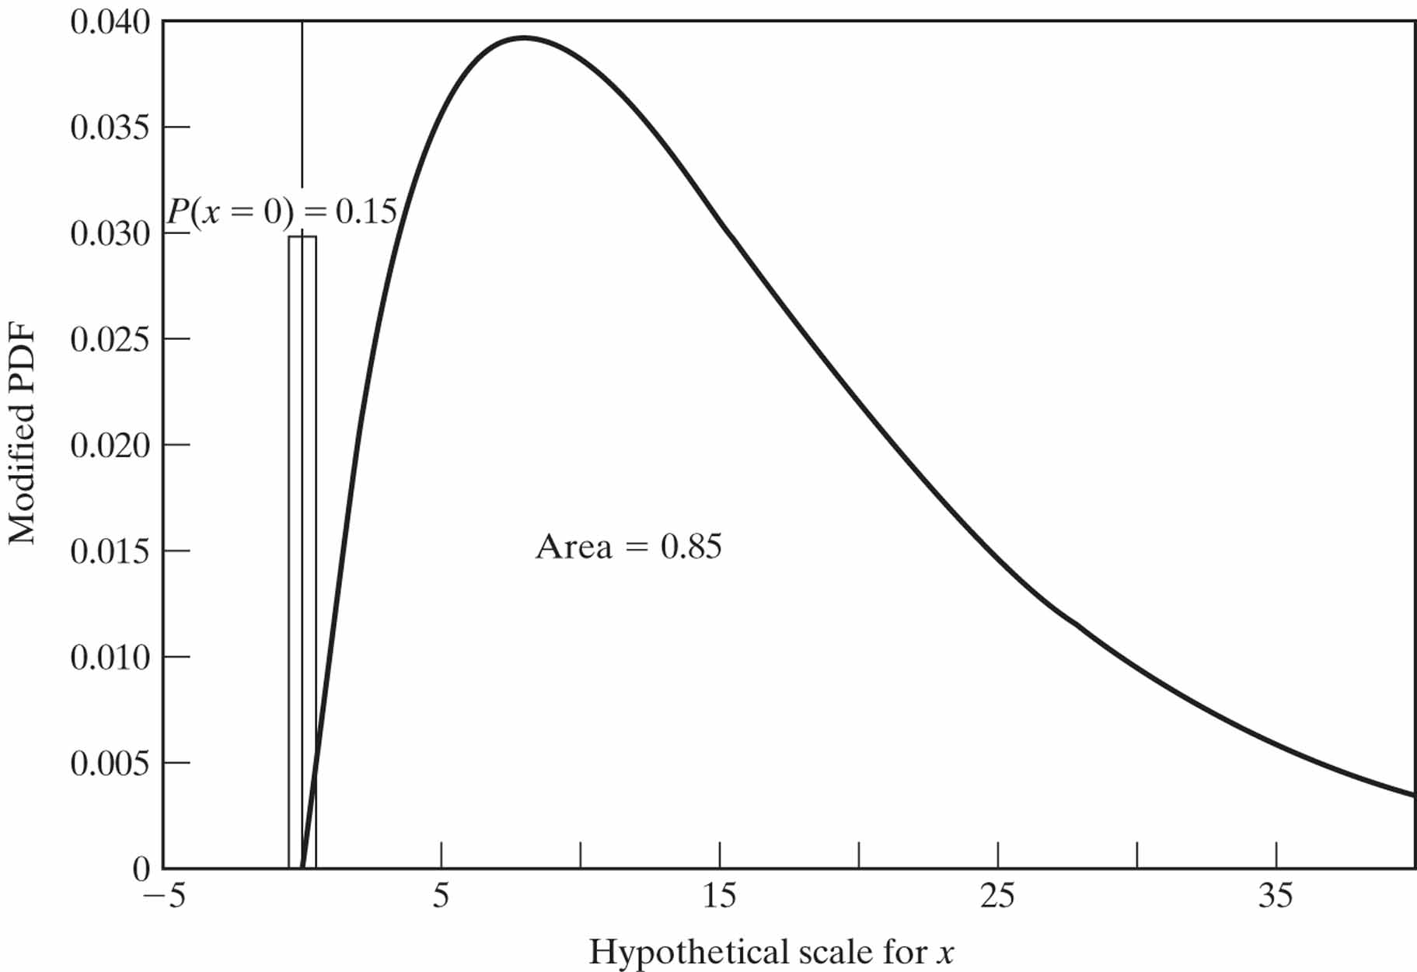
Figure 3-8

Slide 10
Moments of Random Variables
Sample bias correction
N/(N-1)(N-2)

Slide 11
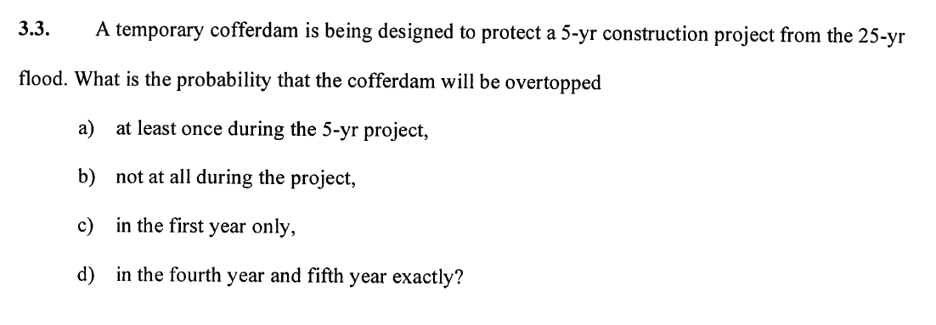
Problem 3-3

Slide 12
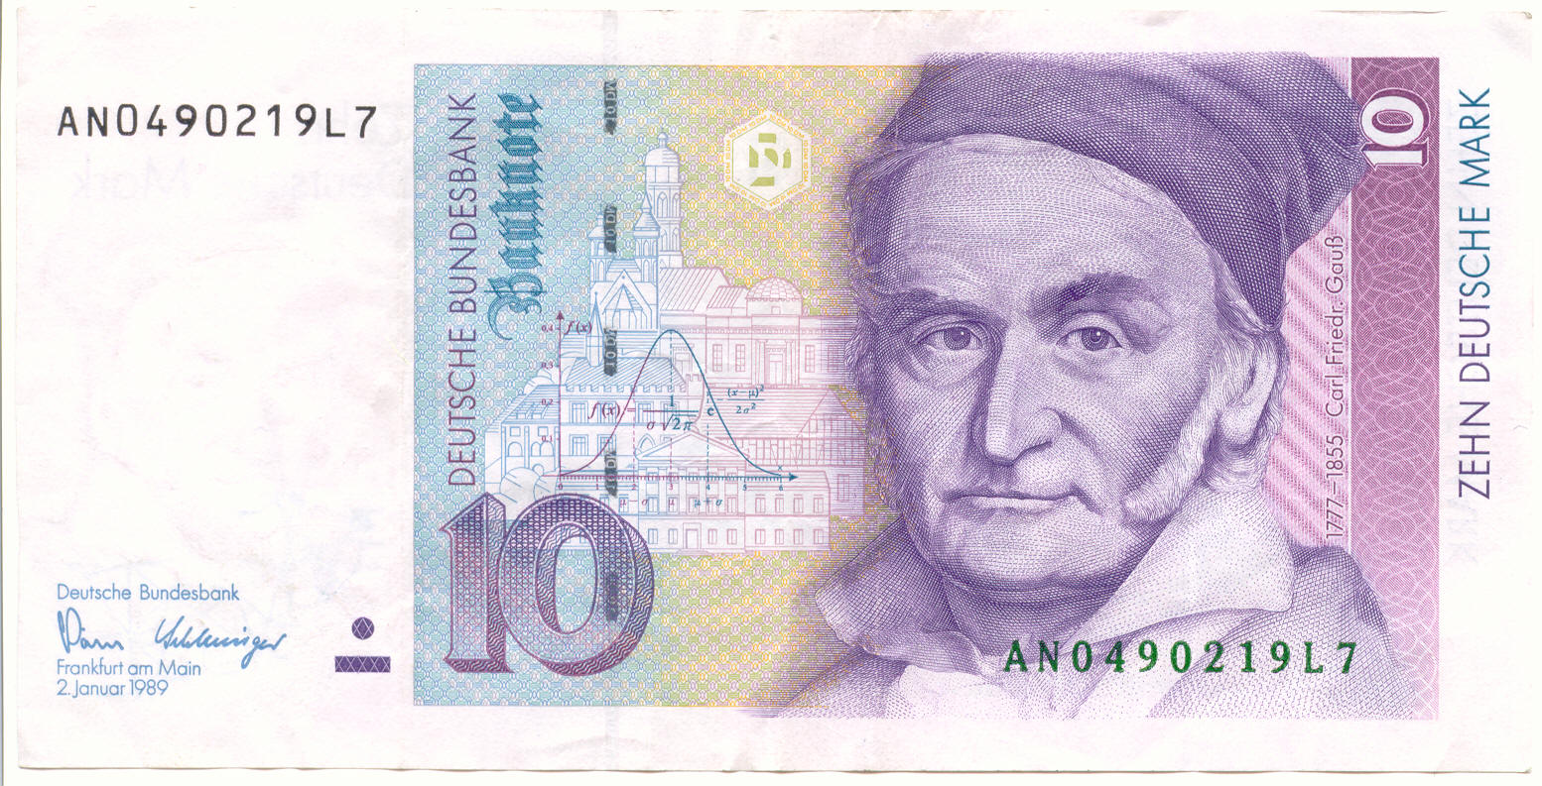
Carl Friedrich Gauß, immortalized
Normal Distribution
3-57

Slide 13
Log Normal Distribution
X is log normally distributed if Y=ln(X) is normally distributed
Derived distribution
Base e logs
Base 10 logs

Slide 14
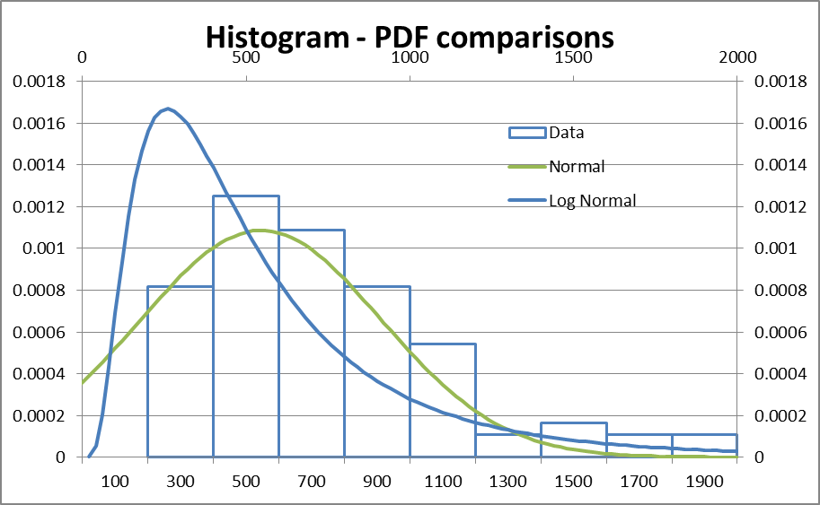

Slide 15
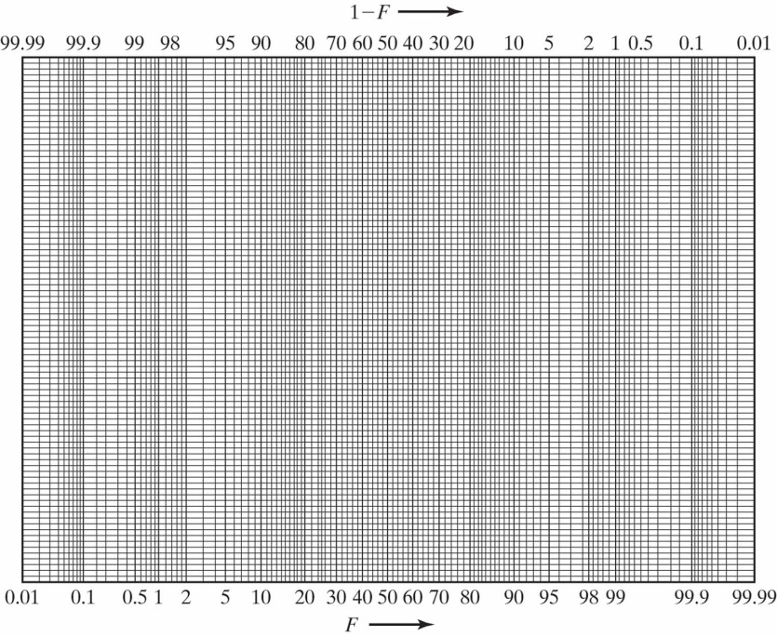
Probability Plots
Cumulative Distribution Function
F(x)
x
Switch Axes
Stretch X axis so that the target distribution plots as a straight line
Achieve this by plotting on the X-axis quantiles corresponding to specific F values and labeling them with the F value
The quantile function is the inverse of the cumulative distribution function
  q = Q(F) = F⁻¹(F), for a given F, evaluate q.
[If possible label x-axis with the F values, but feel free to in Excel just leave quantiles on the x-axis]
x
F(x)

Slide 16
