Slide 1


HydroShare: Advancing Collaboration through Hydrologic Data and Model Sharing
David Tarboton, Ray Idaszak, Jeffery Horsburgh, Dan Ames, Jon Goodall, Larry Band, Venkatesh Merwade, Alva Couch, Jennifer Arrigo, Rick Hooper, David Valentine, David Maidment, Jeff Heard, Pabitra Dash, Tian Gan, Tony Castronova, Stephen Jackson, Cuyler Frisby, Stephanie Mills, Brian Miles
USU, RENCI, BYU, UNC, UVA, CUAHSI, Tufts, Texas, Purdue, SDSC
http://www.hydroshare.org
OCI-1148453
OCI-1148090
2012-2017

Slide 2
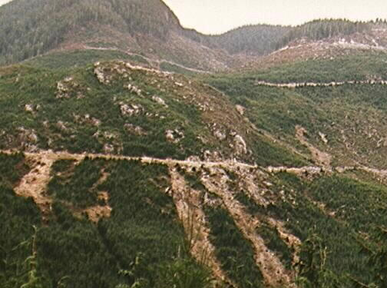
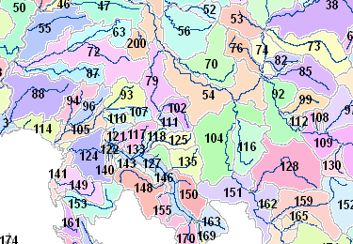
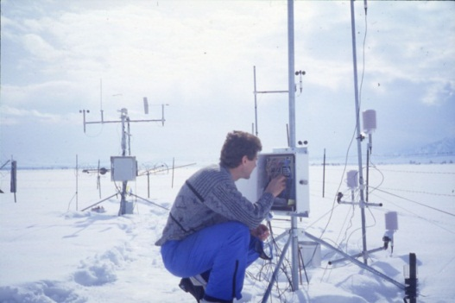
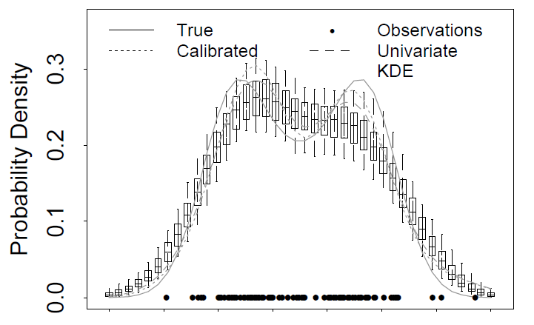
Research Areas
Hydrologic Information Systems
Digital Elevation Model Terrain Analysis
Hydrology and Geomorphology
Distributed Hydrologic Modeling
Snowmelt Hydrology
Non parametric stochastic hydrology
Streamflow regimes for stream ecology
The Great Salt Lake
Catalog
Metadata
ODM, WaterML
Search
Server
Data
Desktop

Slide 3

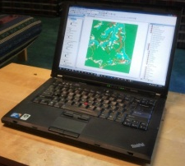
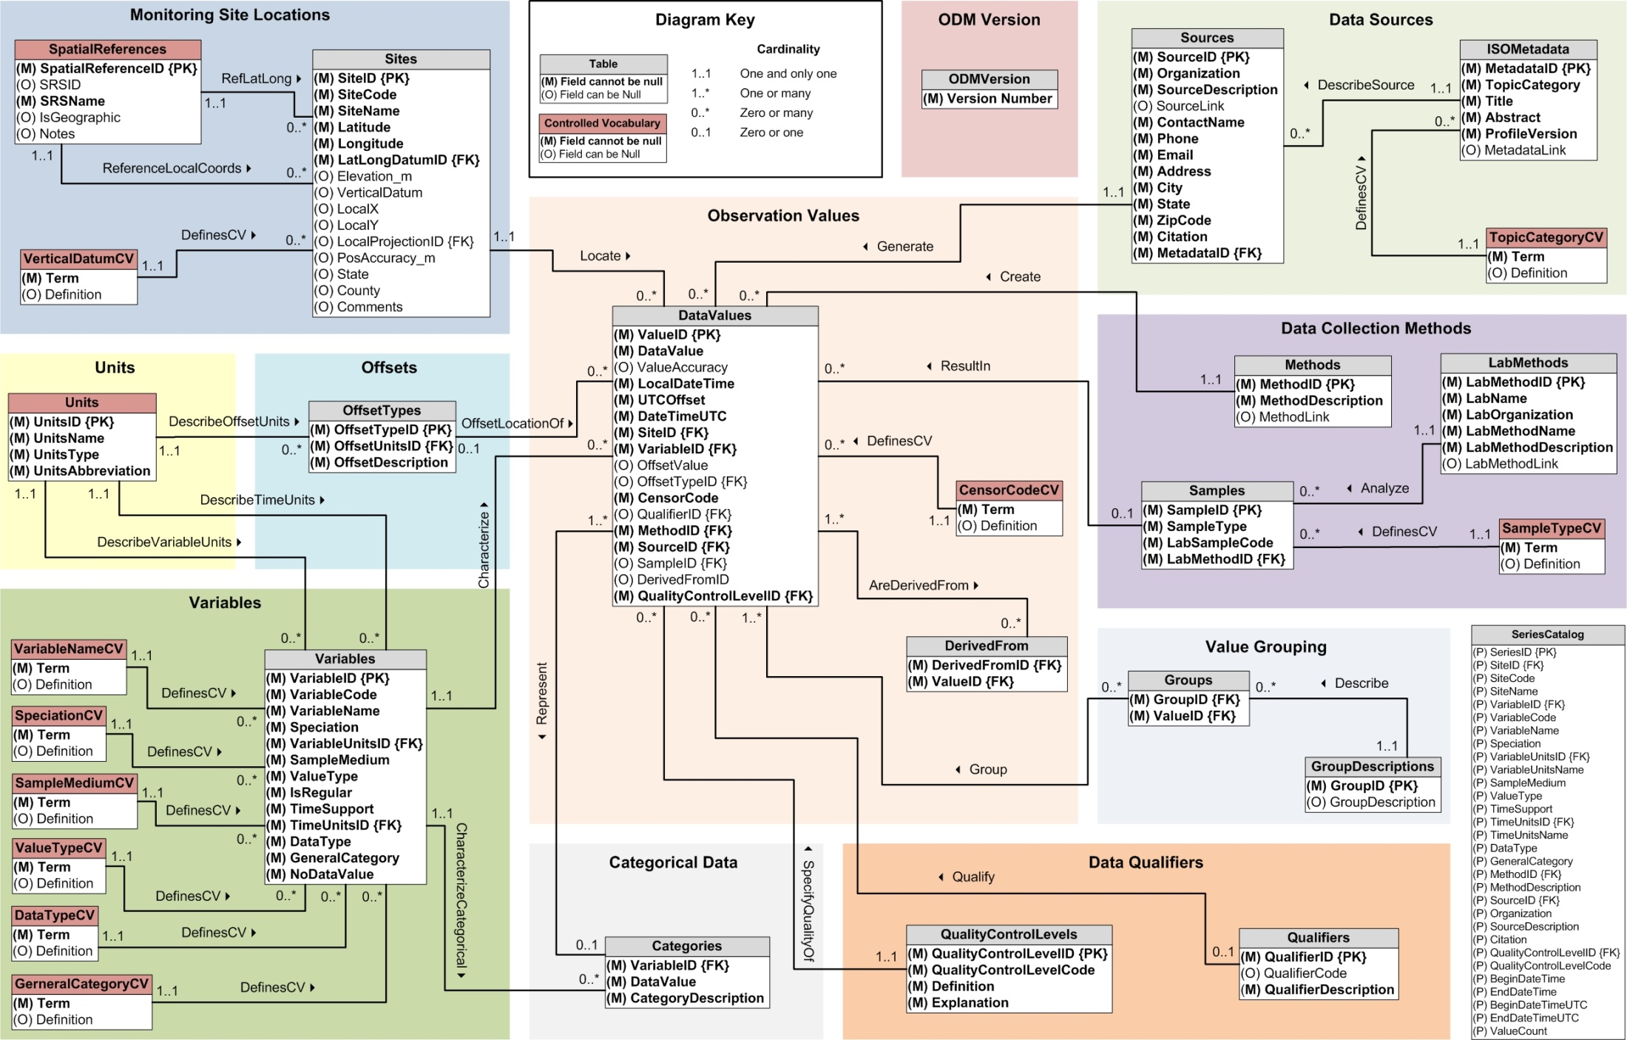
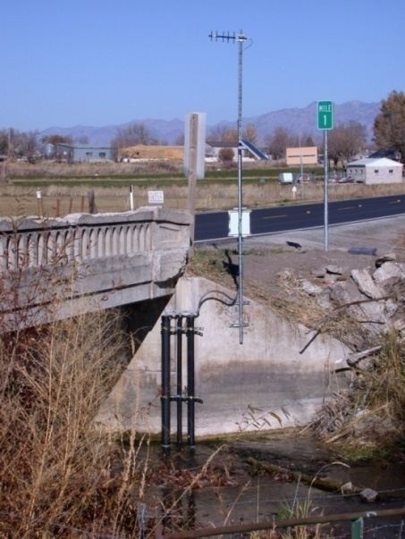
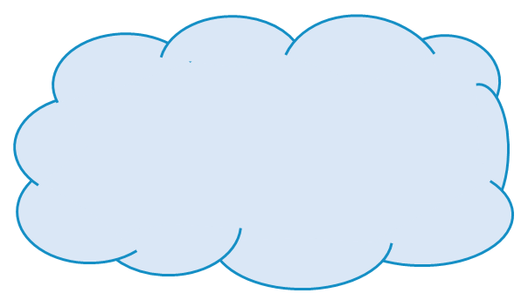
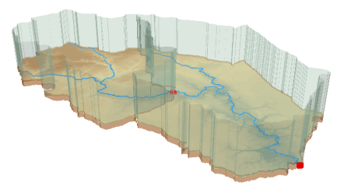



Outline
Hydrologic data and computational challenges
Hydrologic Terrain Analysis (TauDEM -> CyberGIS)
CUAHSI HIS Services-Oriented Architecture
  Standards for hydrologic data storage and exchange
  Catalog for data discovery
  Integration of information from multiple sources
HydroShare
  Collaborative data analysis and publication
  Collaborative integrated modeling
  Architecture (Resource Centric Paradigm)
  Resource Data Model
  Functionality (to be) developed

Slide 4
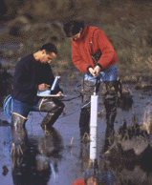


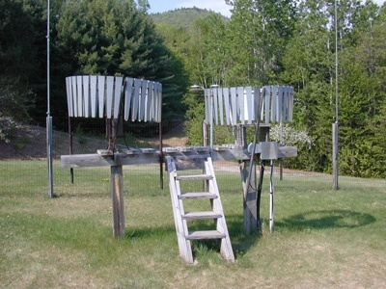
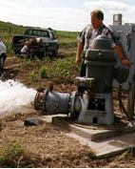
Hydrologic Data Challenges
Water quality
Water quantity
From dispersed federal agencies
From investigators collected for different purposes
Different formats
  Points
  Lines
  Polygons
  Fields
  Time Series
Rainfall and Meteorology
Soil water
Groundwater
GIS
Data Heterogeneity

Slide 5
What proportion of your research time do you spend on preparing or preprocessing data into appropriate forms needed for research purposes?
http://his.cuahsi.org/documents/HISStatusSept15.pdf
Notes:
Surveys of the hydrology community have indicated that data gathering and preprocessing is an inordinate fraction of the time required for modeling and analysis
In hydrology most of the easy single site, single variable, low hanging fruit research problems are solved and advances in understanding and better predictions require
combining information from multiple sources,
sharing and collaboration
Easier access to advanced computational capability
Sustainability and reliability in software

Slide 6
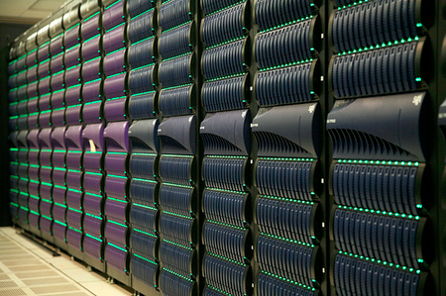

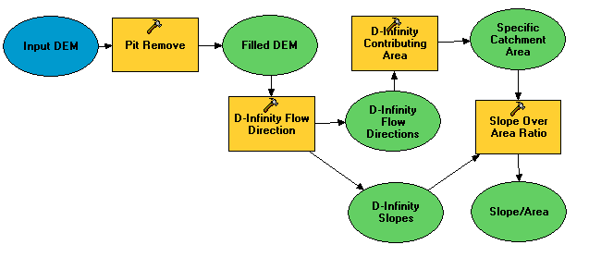

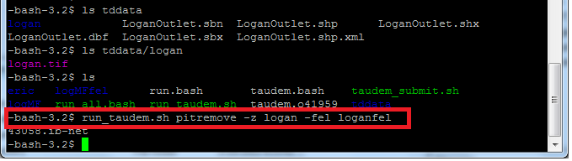
A digital divide
Researchers
Experimentalists
Modelers
Big Data and HPC
#!/bin/bash
vi
chmod
#PBS -l nodes=4:ppn=8
grep
awk
mpiexec
Do you have the access or know how to take advantage of advanced computing capability?
Gateways, Web Interfaces, Software services

Slide 7




TauDEM is software for deriving Hydrologically Useful Information from Digital Elevation Models
Raw DEM
Pit Removal
Flow Field
Flow Related Terrain Information
Notes:
This slide shows the general model for deriving flow field related derivative surfaces from digital elevation data. The input is a raw digital elevation model, generally elevation values on a grid. This is basic information used to derive further hydrology related spatial fields that enrich the information content of this basic data. The first step is to remove sinks, either by filling, or carving. Then a flow field is defined. This enables the calculation of flow related terrain information.

Slide 8




The challenge of increasing Digital Elevation Model (DEM) resolution
e.g. 50,000 km²
Watershed
1980’s DMA 90 m
10² cells/km²
27 MB
1990’s USGS DEM 30 m
10³ cells/km²
240 MB
2000’s NED 10 m
10⁴ cells/km²
2 GB
2010’s LIDAR ~1 m
10⁶ cells/km²
200 GB

Slide 9
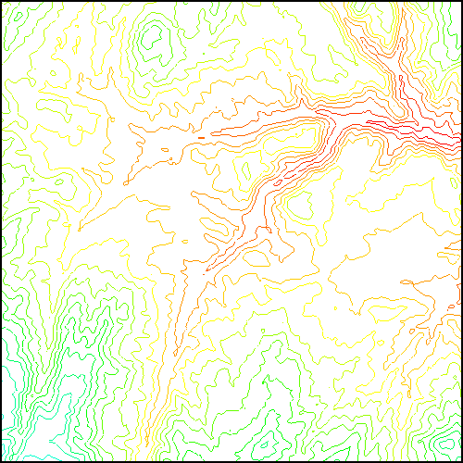
Parallel Pit Filling
Communicate
Initialize( D,P) Do for all i in P if D(i) > n P(i) ← D(i) Else P(i) ← n endfor Send( topRow, rank-1 ) Send( bottomRow, rank+1 ) Recv( rowBelow, rank+1 ) Recv( rowAbove, rank-1 ) Until P is not modified
Init.
1st Pass
2nd Pass
D denotes the original elevation.
P denotes the pit filled elevation.
n denotes lowest neighboring elevation
i denotes the cell being evaluated
Parallel extension of: Planchon, O., and F. Darboux (2001), A fast, simple and versatile algorithm to fill the depressions of digital elevation models, Catena(46), 159-176.

Slide 10



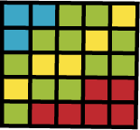
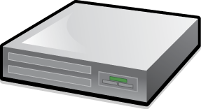




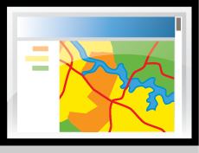
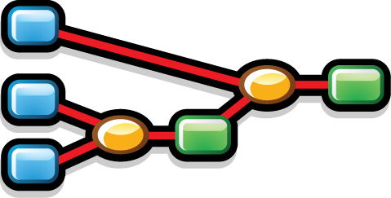
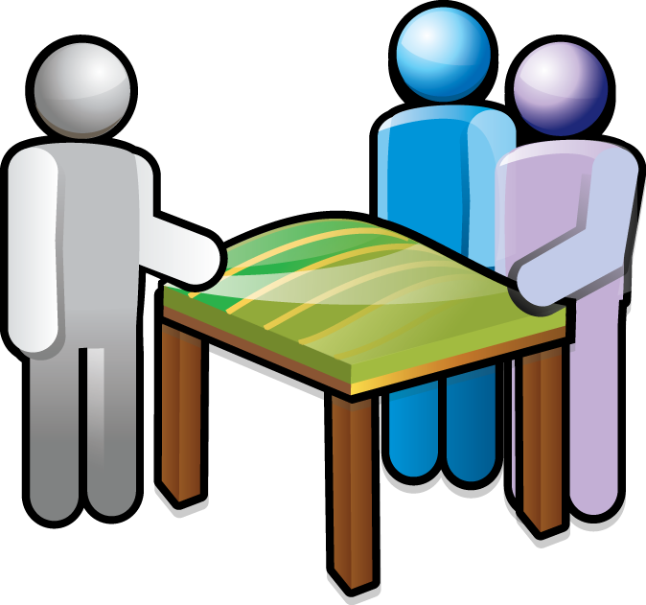
Can we deliver GIS functionality in general, and TauDEM specifically, as a service over the web
Data Sources
Server
Functions and Tools
Software as a Service
Users
Based on slide from Norm Jones

Slide 11
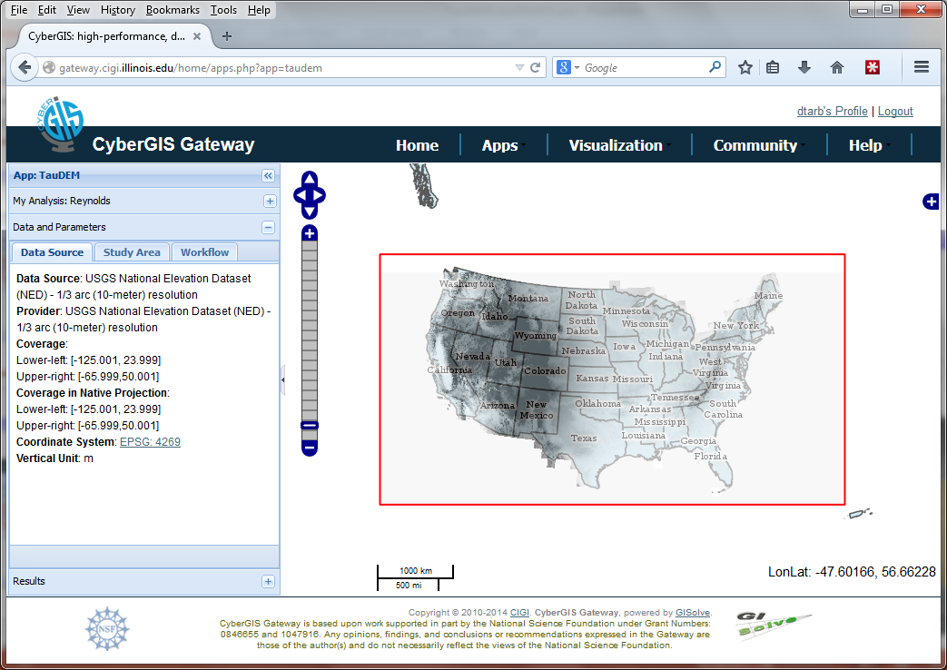
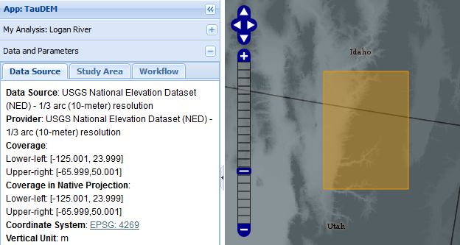

Slide 12
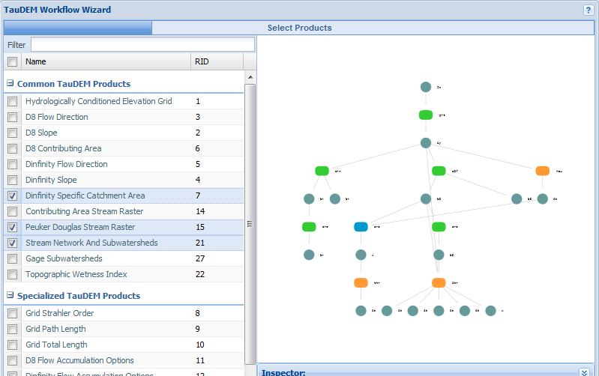
Select the products you want
The wizard configures the sequence of functions to run to get the result

Slide 13
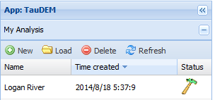
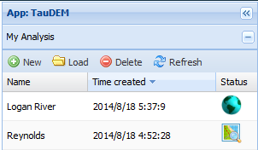
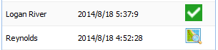
The job progresses through the system
Analysis submitted
Analysis running
Results data created
Results Ready

Slide 14
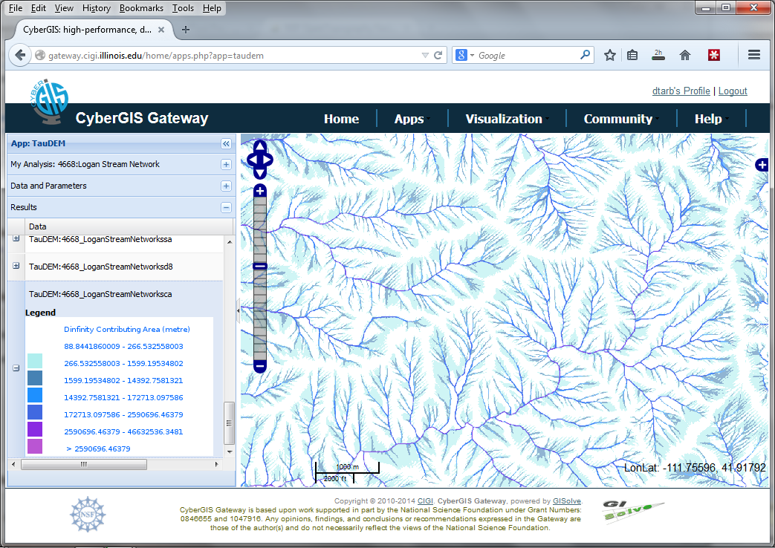
Results displayed in browser

Slide 15
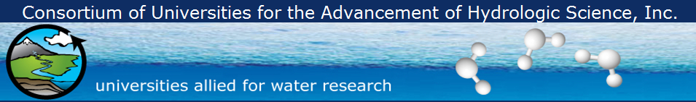
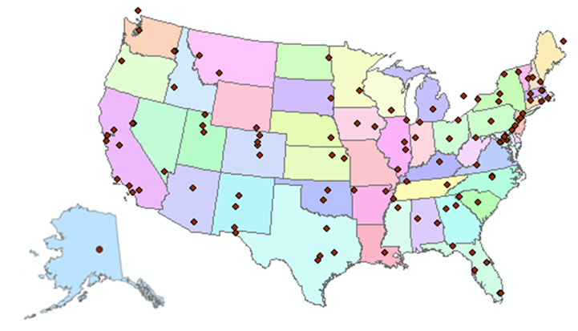
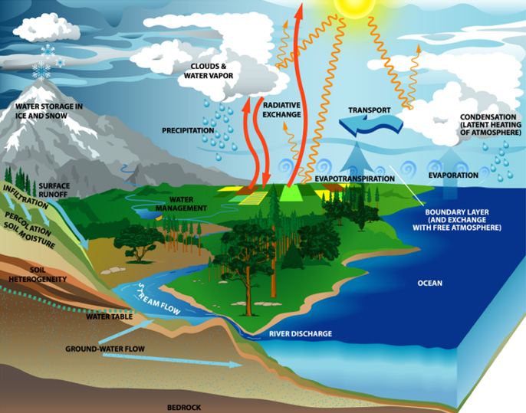
What is CUAHSI?
http://www.cuahsi.org
(as of January 2013)
109 US University members
7 affiliate members
20 International affiliate members
3 corporate members
provides community and research support services to advance water research
Support
EAR 0753521

Slide 16
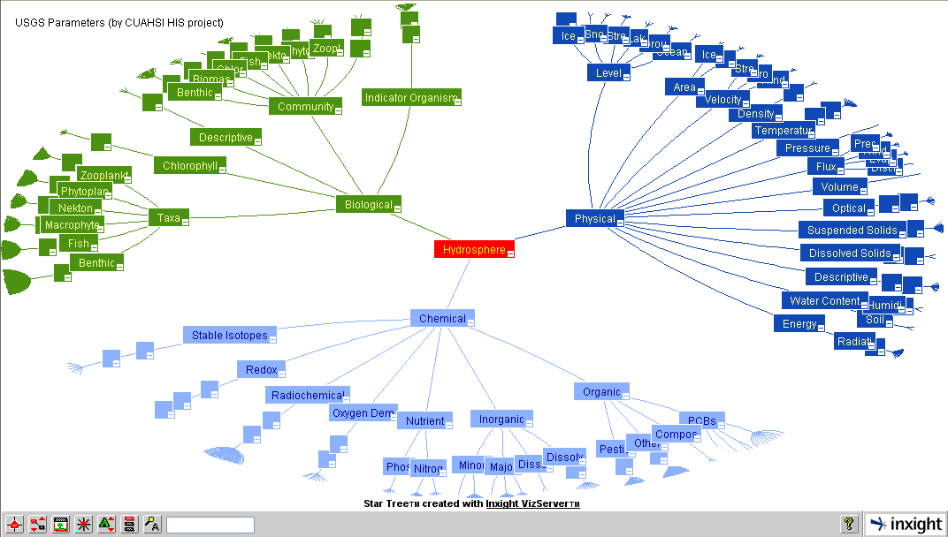
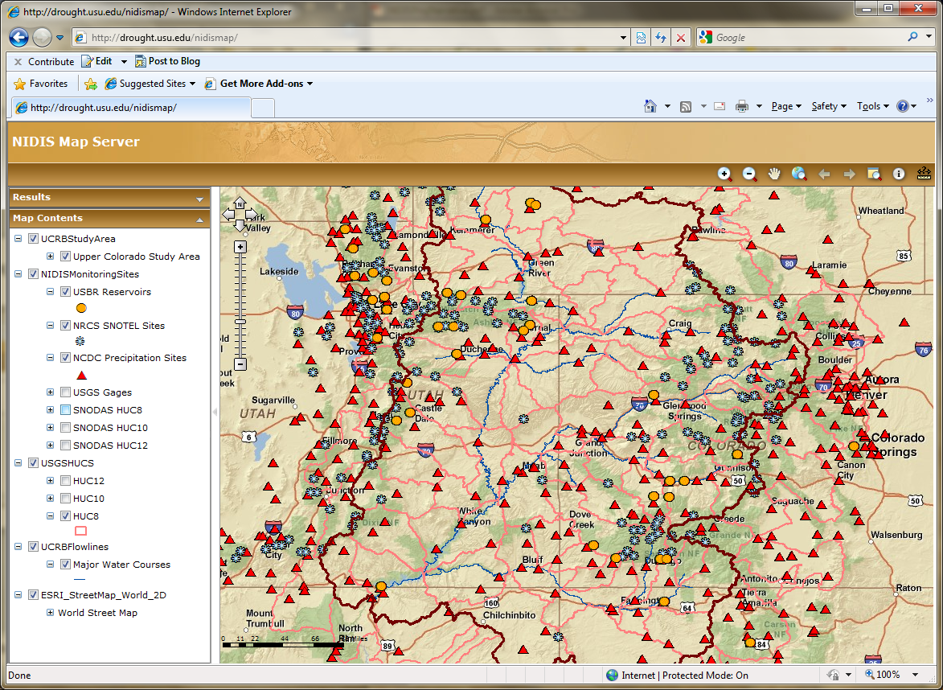
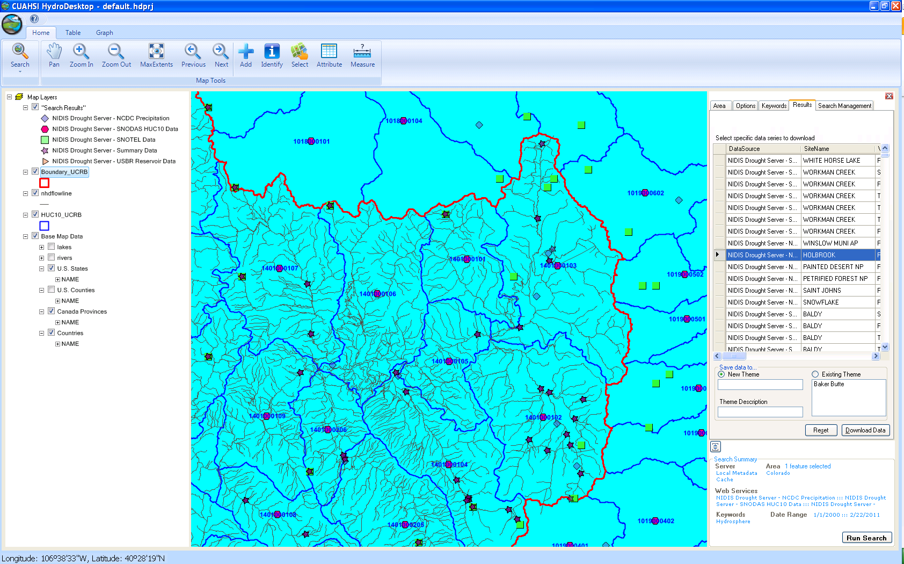
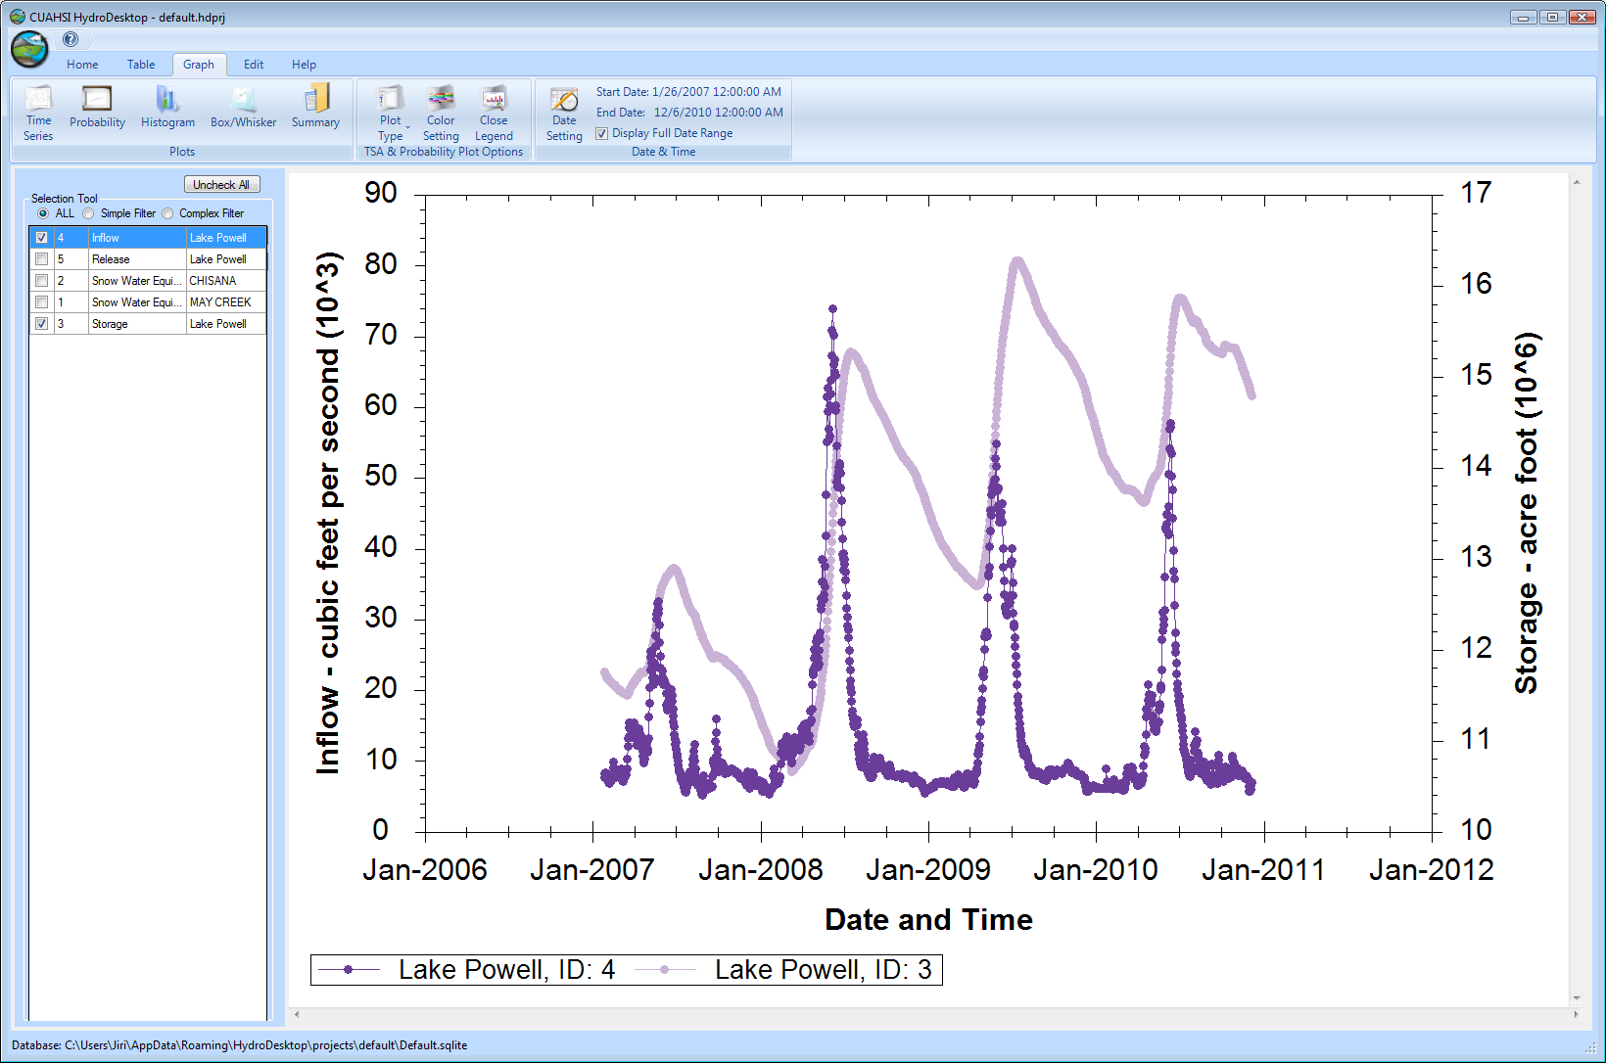
CUAHSI HIS
The CUAHSI Hydrologic Information System (HIS) is an internet based system to support the sharing of hydrologic data. It is comprised of hydrologic databases and servers connected through web services as well as software for data publication, discovery and access.
HydroServer – Data Publication
HydroCatalog
Data Discovery
Lake Powell Inflow and Storage
HydroDesktop – Data Access and Analysis
HydroDesktop – Combining multiple data sources

Slide 17










Data Searching – What we used to have to do
Searching each data source separately
NWIS
request
return
request
request
return
return
NAWQA
request
return
NAM-12
request
return
request
return
request
return
request
return
NARR
Slide: Michael Piasecki, Drexel University
Notes:
17

Slide 18

What CUAHSI HIS enables
Searching all data sources collectively
GetValues
GetValues
NWIS
GetValues
GetValues
generic
request
GetValues
GetValues
NAWQA
GetValues
NARR
GetValues
ODM
Slide: Michael Piasecki, Drexel University
Notes:
18

Slide 19
CUAHSI Hydrologic Information System: A
Services-Oriented Architecture Based System for Sharing Hydrologic Data
HydroCatalog
Data Discovery and Integration
Metadata Services
WaterML, Other OGC Standards
Search Services
HydroServer
HydroDesktop
Data Publication
Data Services
Data Analysis and Synthesis

Slide 20
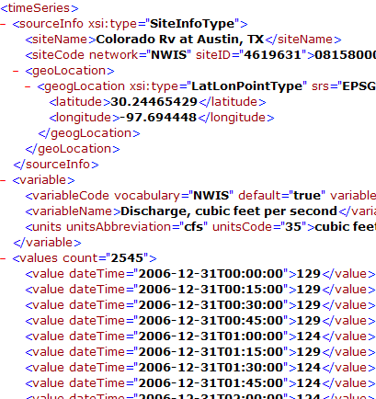
WaterML and WaterOneFlow
WaterML is an XML language for communicating water data
WaterOneFlow is a set of web services based on WaterML
Set of query functions
Returns data in WaterML
GetSites
GetSiteInfo
GetVariableInfo
GetValues
WaterOneFlow
Web Service
Notes:
20

Slide 21
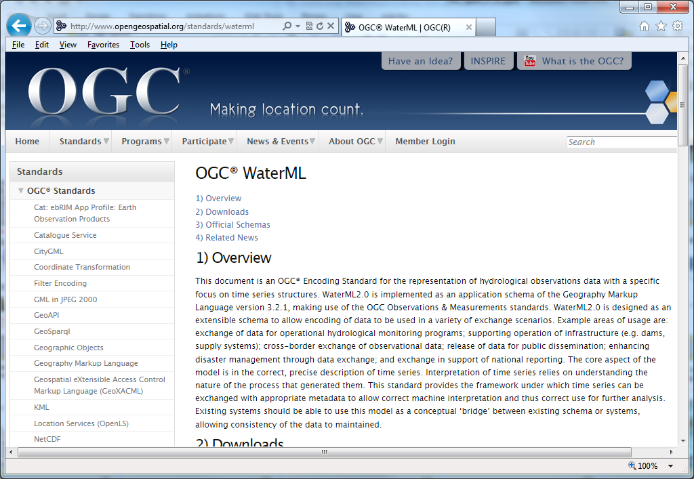
Open Geospatial Consortium Web Service Standards
http://www.opengeospatial.org/standards/waterml
This document is an OGC® Encoding Standard for the representation of hydrological observations data with a specific focus on time series structures.
These standards have been developed over the past 10 years …. by 400 companies and agencies ....

Slide 22
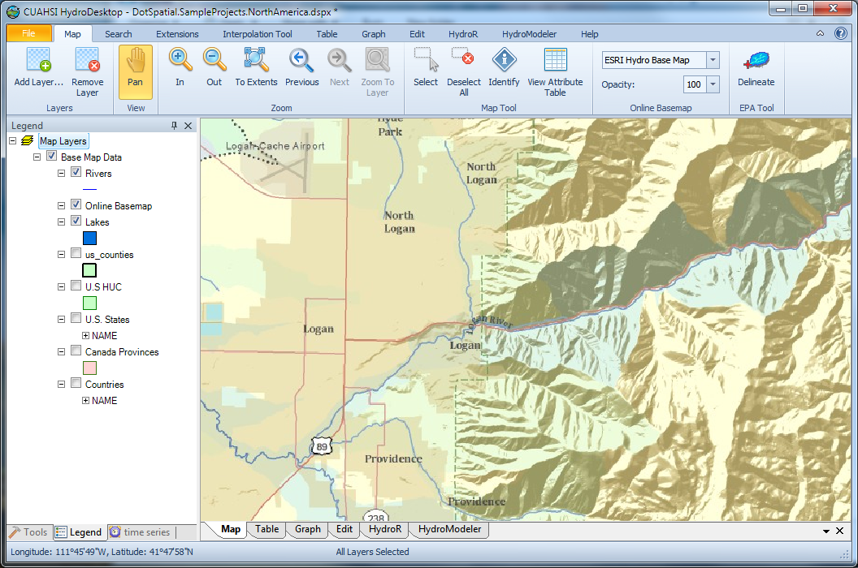
HydroDesktop
An open source
dotSpatial GIS based desktop client that supports discovery and analysis of hydrologic observations data
Uses EPA WATERS Web, Mapping, and Database Services at http://www.epa.gov/waters/geoservices/index.html to delineate Watersheds
Notes:
The service URLs that the HD tool uses are seen in http://hydrodesktop.codeplex.com/SourceControl/changeset/view/475b15a84bf4#Source%2fEPADelineation%2fCallWebService.cs The HD tool uses the Point Indexing Service to find the nearest NHD reach to where the user clicked. This returns a location on that reach. This point location is then used as input to the Navigation Delineation Service to get the watershed, and the Upstream/Downstream Service to get the river lines. The delineation service has two limitations: * It only works up to a certain distance upstream. I think we have it set to 100km. So for large watersheds (those with more than 100km of stream length upstream of where the user clicked), we don't get the most upstream portions of the watershed. * It doesn't delineate exactly to where the user clicked. It delineates to the endpoint of the NHD reach. (Can't remember if it is the clicked reach or the upstream reach -- try it and see.)

Slide 23
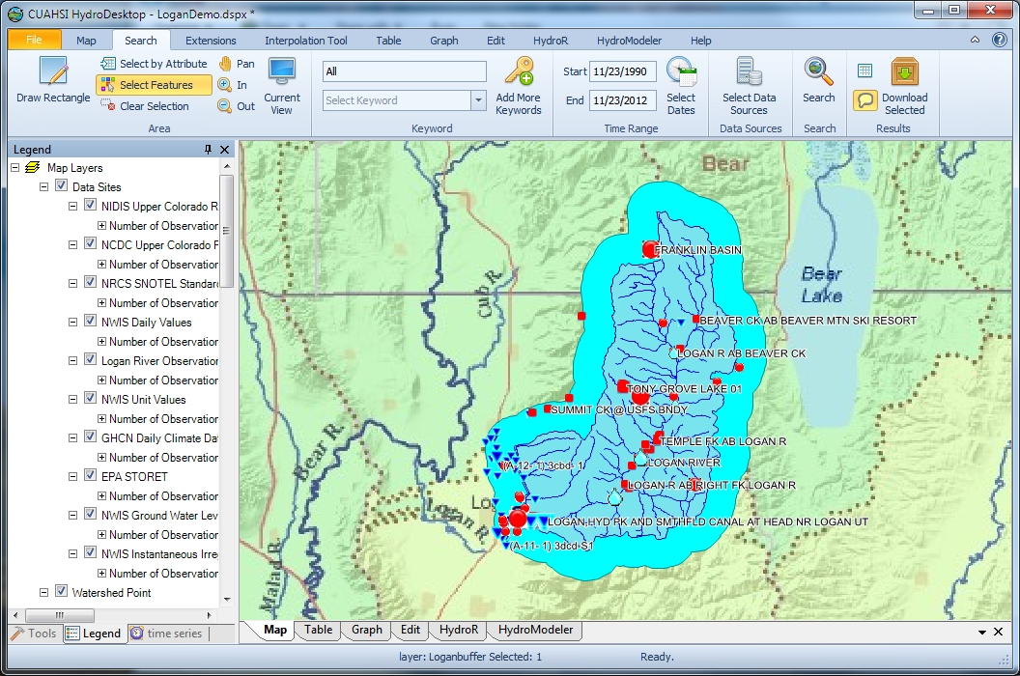
Search last 22 years for all data in buffer around watershed

Slide 24
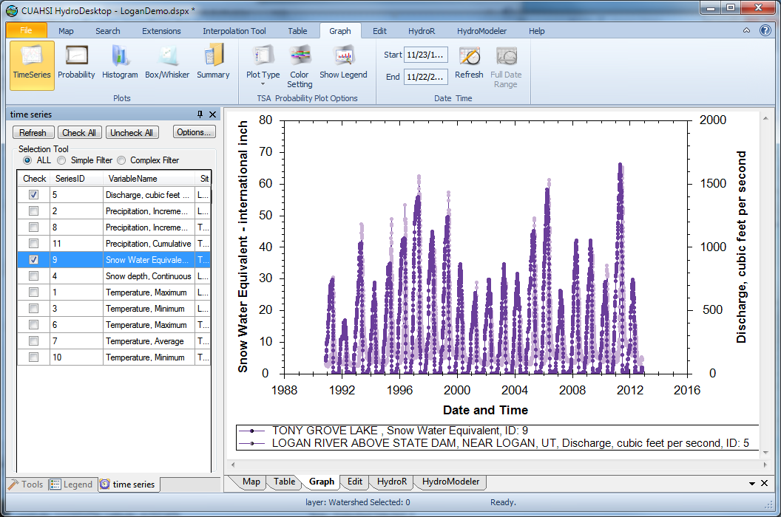
Download and Plot the Data
Combining information from multiple sources

Slide 25
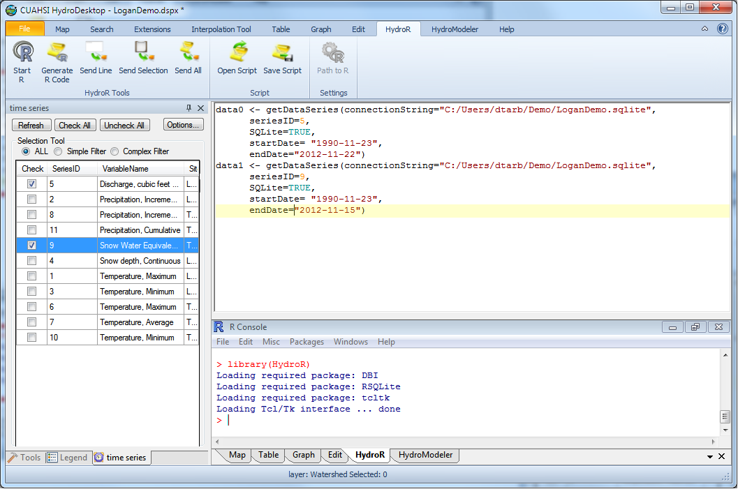
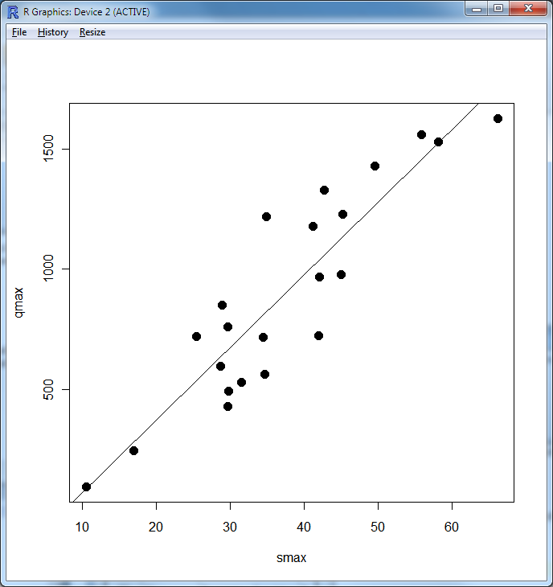
Perform an analysis using R
At your fingertips
the full analysis capability of R
data from multiple sources
accessed from distributed (cloud) resources.
importance of interoperability

Slide 26
CUAHSI HIS: A common window on water observations data for the United States unlike any that has existed before
Storage in a community data model
Publication from a server
Data access through internet-based services using consistent language and format
Tools for access and analysis
Discovery through thematic and geographic search functionality
Integrated modeling and analysis combining information from multiple sources
Desktop
Catalog
Server

Slide 27
But
Publishing data using CUAHSI HIS requires access to or setting up a HydroServer
Accessing data requires HydroDesktop
Generally limited to time series at a point
Desktop
Catalog
Server

Slide 28
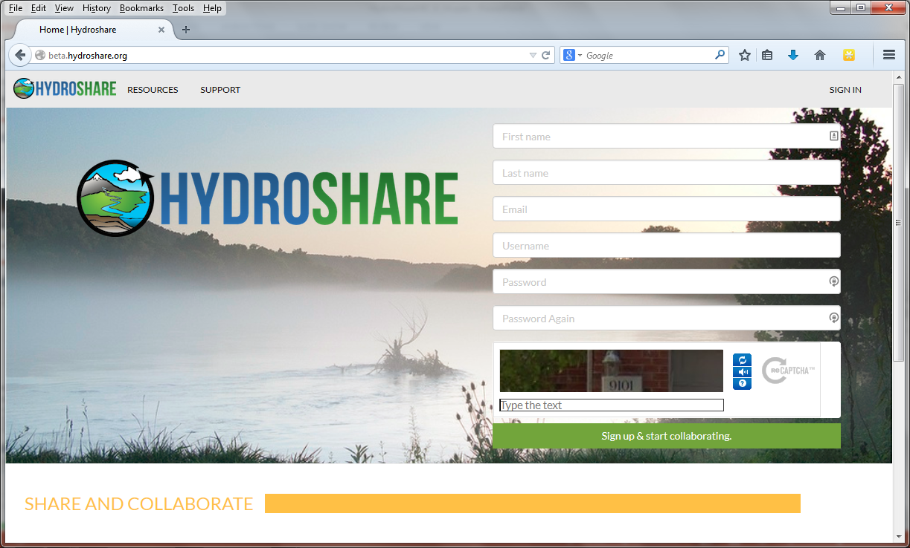
Enable more rapid advances in hydrologic understanding through collaborative data sharing, analysis and modeling
Analysis
Data
Models
USU, RENCI, BYU, UNC, UVA, CUAHSI, Tufts,, Texas, Purdue, SDSC
http://www.hydroshare.org

Slide 29
What is (will) HydroShare (be)?
HydroShare will be a community collaboration website that enables users to easily discover and access data and models, retrieve them to a desktop computer or perform analyses in a distributed computing environment that includes grid, cloud, or high performance computing model instances as necessary.
Understanding will be advanced through the ability to integrate information from multiple sources.
Outcomes (data, results, models) can then be published as new resources that can be shared with collaborators.
Analysis
Data
Models
Our goal is to make sharing of hydrologic data and models as easy as sharing videos on YouTube or shopping on Amazon.

Slide 30
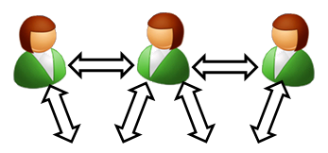


Collaborative data analysis and publication use case
Discover and Analyze/Model (in Desktop or Cloud)
Observe
Publish and Catalog
Collaboration
Analysis
3
CUAHSI Water Data Center
Observers and instruments
HydroServer (ODM)
Data
Models
1
2
Publication, Archival, Curation

Slide 31
Collaborative data analysis and publication use case
Share the results (Data and Models)
Collaboration
Analysis
4
CUAHSI Water Data Center
Observers and instruments
HydroShare resource
store
Data
Models
Publication, Archival, Curation

Slide 32

Collaborative data analysis and publication use case
Group Collaboration using HydroShare
Preparation of a paper
Collaboration
5
Analysis
6
CUAHSI Water Data Center
Observers and instruments
Data
Models
Publication, Archival, Curation

Slide 33
Collaborative data analysis and publication use case
Submittal of paper, review, archival of electronic paper with data, methods and workflow
Collaboration
Analysis
7
CUAHSI Water Data Center
Observers and instruments
Data
Models
Publication, Archival, Curation

Slide 34

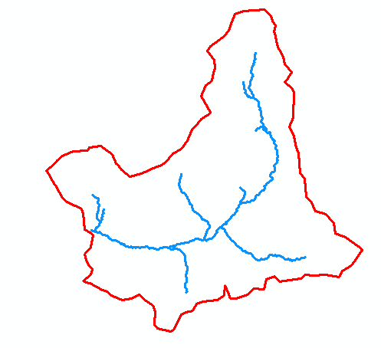
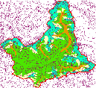
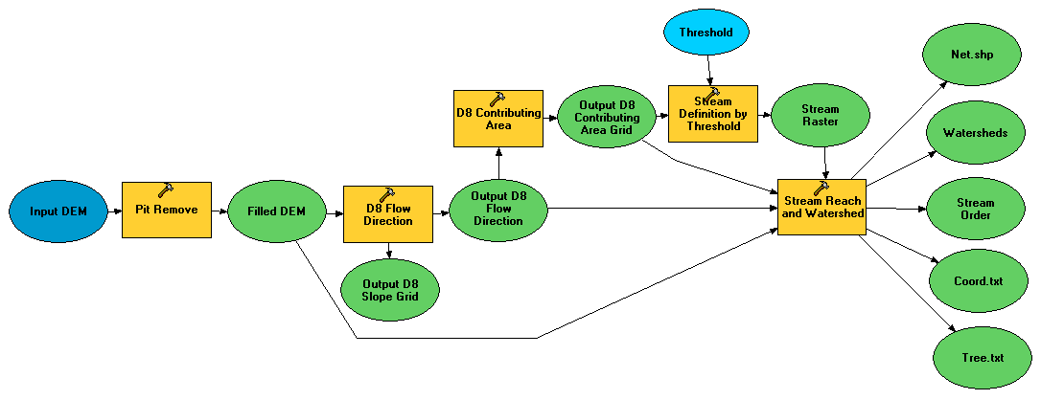
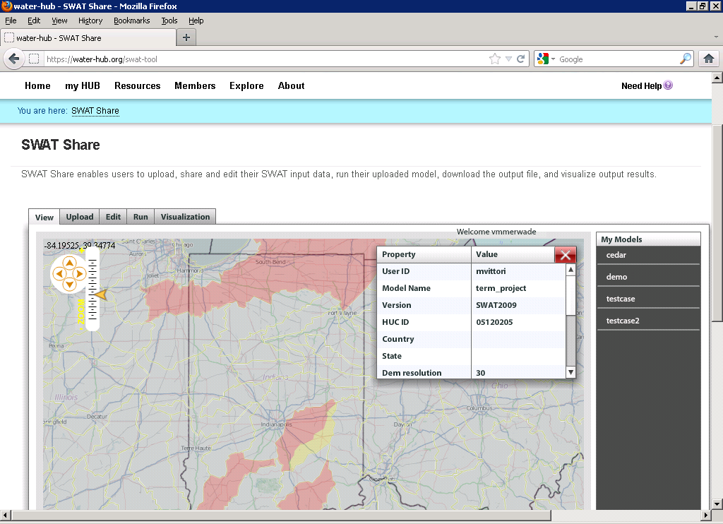
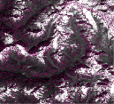
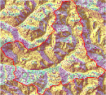






Collaborative Integrated Modeling Use Case
Flow
Time
P
Flow
Time
t
Time
Pre-processing and model linking
y
x
Modeling Services (e.g. SWATShare)
Data: Links to national and global data sets of essential terrestrial variables (e.g. NASA NEX, HydroTerre)
Tools to preprocess and configure inputs (EcoHydroLib, TauDEM, CyberGIS)
Preconfigured models and modeling systems as services (SWATShare)
Standards for information exchange for interoperability (OpenMI, CSDMS BMI)
Tools for visualization and analysis
Notes:
Data: Links to national and global data sets of essential terrestrial variables (e.g. NASA NEX, HydroTerre)
Tools to preprocess and configure inputs
Preconfigured models and modeling systems as services
Standards for information exchange for interoperability (OpenMI, CSDMS BMI)
Tools for Visualization and Analysis
Automated reasoning to couple models based on purpose, context, data and resources

Slide 35
Definition of Data
In OMB Circular A-110 research data is defined as “recorded factual material commonly accepted in the scientific community as necessary to validate research findings, but not any of the following: preliminary analyses, drafts of scientific papers, plans for future research, peer reviews, or communications with colleagues.”
Validating research findings may involve
Observations and measurements
Models, code and scripts
Simulation results
HydroShare resources need to accommodate all these types of “data”

Slide 36
Resource Repository Centric Paradigm for Modeling and Analysis
Models
Visualization Tools
Analysis Tools
Resource Repository
Data Loaders
Data Discovery Tools
Each model interacts with information in the common data store
The modeler does not need to be concerned with and can take advantage of standardized analysis, visualization loading and discovery tools
Enable multiple models to use common “best practice” tools

Slide 37



Resource Data Model
Open Archives Initiative – Object Reuse and Exchange (OAI-ORE) - standards for the description and exchange of aggregations of Web resources
BagIt – hierarchical file packaging format designed to support disk-based or network-based storage and transfer of generalized digital content
Compatible with DataOne

Slide 38
Types of data to support as resources
Resource Types
Generic ✓
Time Series (CUAHSI HIS)
Geographic feature set
Geographic Raster
Referenced HIS time series
Multidimensional Space Time dataset
River geometry
Sample based observations (ODM2 and CZO)
Documents
Tabular objects
HydroDesktop Project package
Scripts
Models
Model Components
Referenced data sets from other (non HIS) sources.
Tools
Uploaders to facilitate loading of resources
Viewers to visualize the resource
Exporters to download the resource
Best practice tools for hydrologic data preprocessing and analysis
Resource Data Model.
Data and metadata content
Logical relationships
File formats

Slide 39


Multidimensional Space Time Resource Type
Time Series Resource Type
t
ODM/WaterML
y
x
NetCDF

Slide 40




Representing River Geometry in HydroShare
LiDAR
Cross Sections Attached to River Network
Cross Sections
Hydraulic Calculations

Slide 41

Models
Model package
  Bundled components
  references existing resources
Model program
  executable entity
  may consist of submodules and other complex relationships
Model input
  input required by a program
  files, parameters, etc...
Model output
  outputs produced by a program
  files, plots, etc...

Slide 42

Model Execution in HydroShare
Input and output Hydroshare resources
Link input, output, and program resources to create model packages
Execution of model package within the HydroShare environment to create "new" resources
Output
CREATE OUTPUT
CREATE PACKAGE
Package
EXECUTE
Program
Input
Package
Program
Input
Output

Slide 43

SWATShare

Slide 44
RHESSys ecohydrology data preparation workflow
Common across many models
Manual workflows
Workflow framework
Notes:
Explain what pieces have been implemented as iRODS rules.
Explain what iRODS is.

Slide 45
Architecture Outline
Users
Browser
Client
Web Pages
Web Services (REST API)
HydroShare

Slide 46
Architecture
Users
Browser
Client (HydroDesktop)
3rd party clients, interoperable systems and web tools
Web Tools
Web Pages
Web Services (HydroShare REST API)
Compute Engines (Docker or HPC)
Connection point for partners
BiG CZ SSI
CI-WATER
SEAD
CyberGIS
SESYNC GI Venture
Django web application framework
iRODS Native REST API
iRODS “Network File System”
Content
Resource Files
Resource Science Metadata
User Accounts
Functionality
Authentication and Authorization Infrastructure (AAI) for Access Control
Discovery (using e.g. ElasticSearch via MSVC plugin)

Slide 47


Slide 48



Slide 49


Sharing and collaboration

Slide 50
Summary
A new, web-based system for advancing model and data sharing
Sharing features to HydroDesktop
Access more types of hydrologic data using standards compliant data formats and interfaces
Enhance catalog functionality that broadens discovery functionality to different data types
New model sharing and discovery functionality
Facilitate and ease access to use of high performance computing
New social media and collaboration functionality
Links to other data and modeling systems

Slide 51

Thanks to the HydroShare team!
  USU
  RENCI/UNC
  CUAHSI
  BYU
  Tufts
  UVA
  Texas
  Purdue
  SDSC
http://hydroshare.cuahsi.org
OCI-1148453
OCI-1148090
2012-2017
Notes:
The HydroShare project is part of a broad effort in CUAHSI in the area of Hydrologic Information Systems. We have a team of developers and domain scientists from eight universities working on HydroShare. This is part of the even broader focus in NSF on data management, Cyberinfrastructure and sustainable software.

